Slide 1
Get Ready to ShakeOut!
Name
Organization

Slide 2
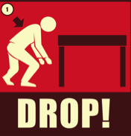
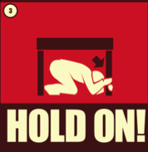
Great ShakeOut Earthquake Drills
Annual multi-state, multi-country, all-sector preparedness events when millions of people practice
Many do much more! Register at ShakeOut.org/california

Slide 3
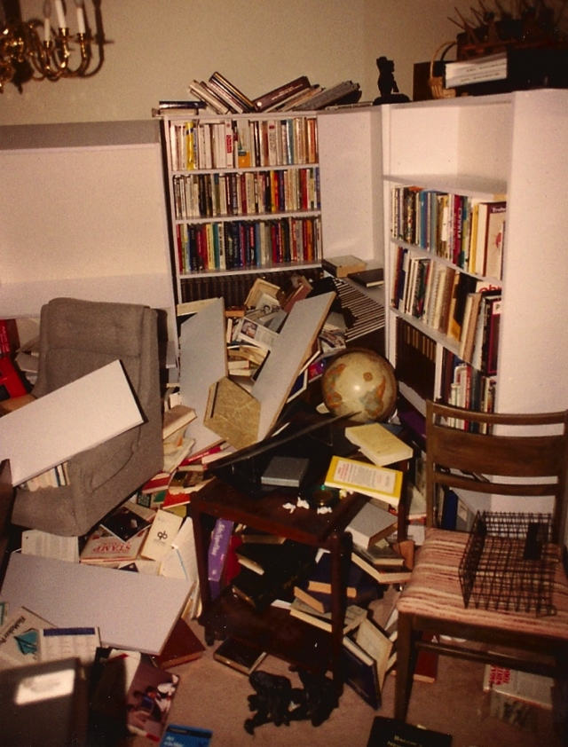
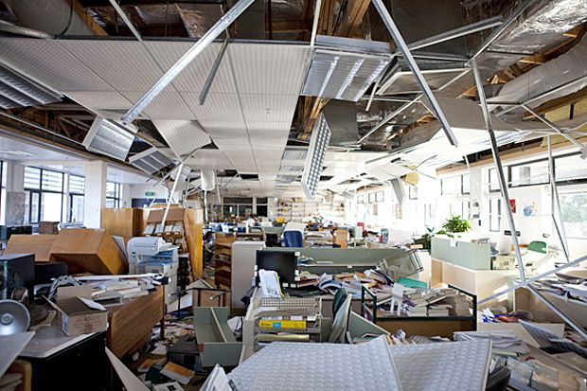
Why Drop, Cover, and Hold On?
Buildings may be damaged but rarely collapse
People are injured primarily by objects falling on them or while moving
Notes:
[read the slide]

Slide 4
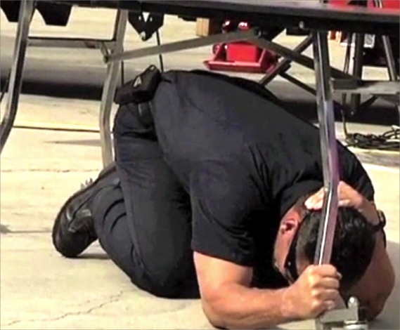
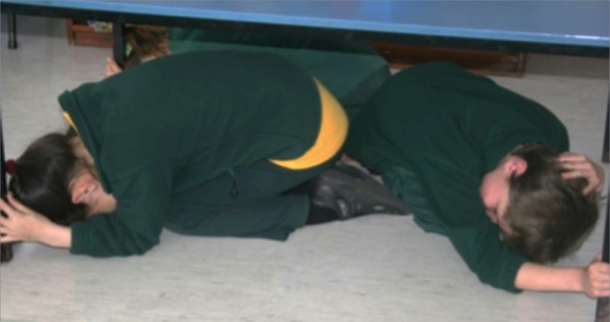
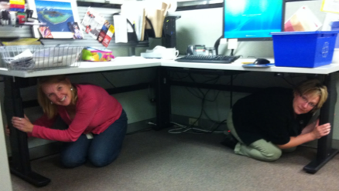
How to Protect Yourself (most situations)
Drop to the floor
Before the earthquake drops you!
If inside, don’t run out!
Take Cover
Under a sturdy desk or table
Or get down next to a wall and cover your head/neck with your hands and arms
Hold On to your shelter
Be ready to move with it until the shaking stops.
Everyone, everywhere, should know these basic steps
Notes:
ShakeOut.org/california has instructions for what to do in many situations, including if someone cannot drop to the floor.

Slide 5
Why Do People Get Prepared?
Research by Mileti, Bourque and others:
They see and hear consistent information about what to do frequently, in many forms, and from many sources
They see others like themselves getting prepared
They talk about preparedness with people they know
They learn potential consequences, and how to avoid them
The Great ShakeOut puts these findings into practice
5
Notes:
5
[Read Slide]
This is based on many years of social science research
These are the core practices of the ShakeOut and Earthquake Country Alliance.

Slide 6
ShakeOut Goals
Participation of millions of people
Participants practice how to protect themselves: Drop, Cover, and Hold On!
Register at www.ShakeOut.org/california
Shift the culture about earthquakes & preparedness
Get people talking with each other about preparedness
Come together around a common vision for resiliency
Increase in earthquake readiness at all levels
Whole of Community: families, communities, schools, non-profits, businesses, government, and all others…
Build Resilience: Our capacity to survive and recover quickly

Slide 7
ShakeOut History
Began in Southern California in 2008
Based on comprehensive “ShakeOut Scenario” created by USGS and many partners for a 7.8 magnitude earthquake
Became the scenario for a state-led emergency management exercise
ShakeOut drill created by Earthquake Country Alliance partners to involve families, schools, and organizations
5.4 million Southern California participants
More participants and additional states/countries each year
2009: 6.9 million statewide in California
2010: 8 million in California, Nevada, and Guam
2011: 12.1 million, 15 states/territories & British Columbia
2012: 19.4 million, 26 states/territories, 5 countries with official drills
2013: 20+ million, 43 states/territories, expansion across Japan

Slide 8
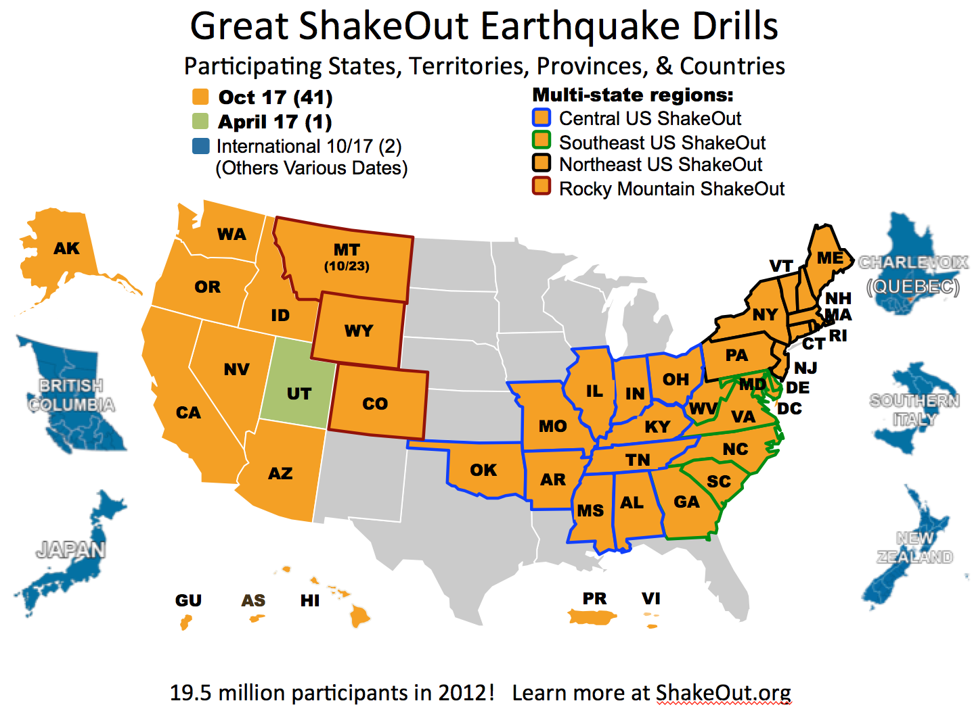
Nationwide and International
(Official ShakeOut Regions also include British Columbia, Quebec, Japan, New Zealand, & Italy, with additional participation each year in more than 15 other countries)
Notes:
Everyone… everywhere! The ShakeOut has spread across the US and beyond! Potentially in 2013: 40+ states, 6 other (district, commonwealth, or territory)
Engaged more than 19.4 million people in 2012 (9.4 million California, 7.7 million other U.S., 2.3 million globally).

Slide 9
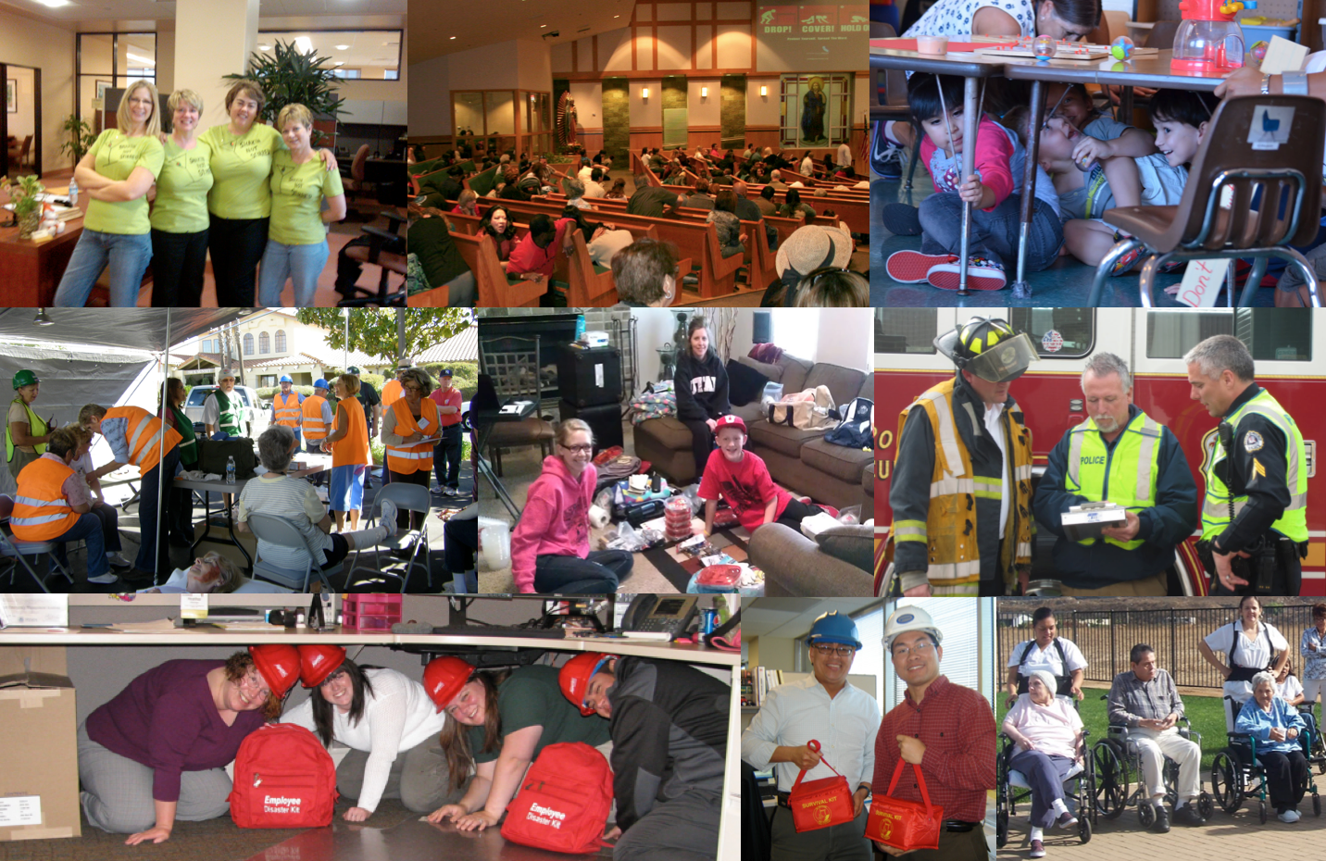
Everyone can ShakeOut!

Slide 10
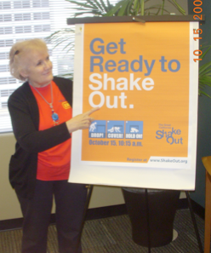
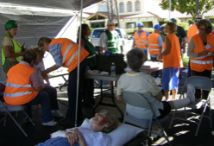
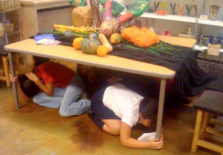
Key ShakeOut Elements
Public and Private Partners
Many people and organizations working together to promote and improve preparedness, mitigation, and resilience
A Whole Community approach
Customized information for over 20 categories of participants
ShakeOut.org website
Online registration and listing of participants
Instructions for many types of organizations
ShakeOut Drill Manuals
Schools, Businesses, Organizations, and Government Agencies
Multiple levels of drills (simple to advanced)
Drill Broadcasts (audio and video narrated instructions)
Radio, TV, and print promotion and PSAs
Extensive traditional and social media coverage/interaction
41

Slide 11
ShakeOut Website
Central place to register, download drill planning resources, and see who is participating
www.shakeout.org/california
Notes:
11

Slide 12
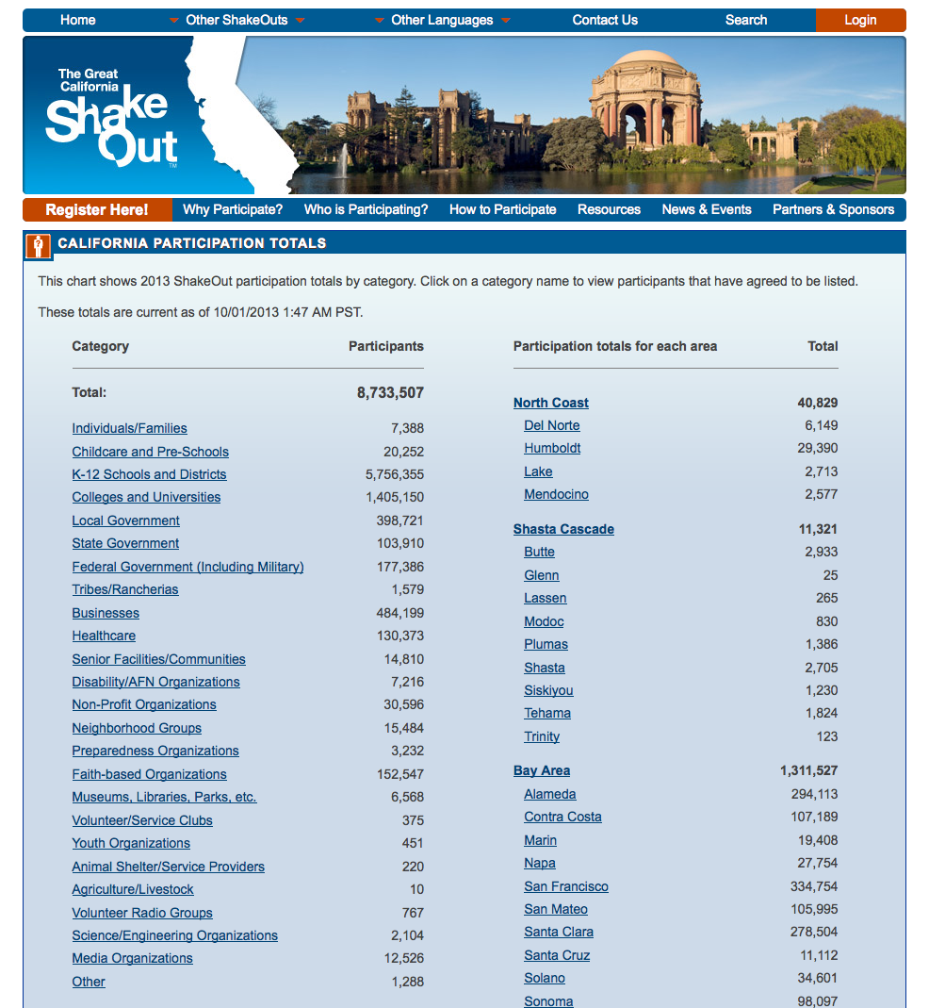
Buildings at Risk Summit
12
Notes:
12

Slide 13
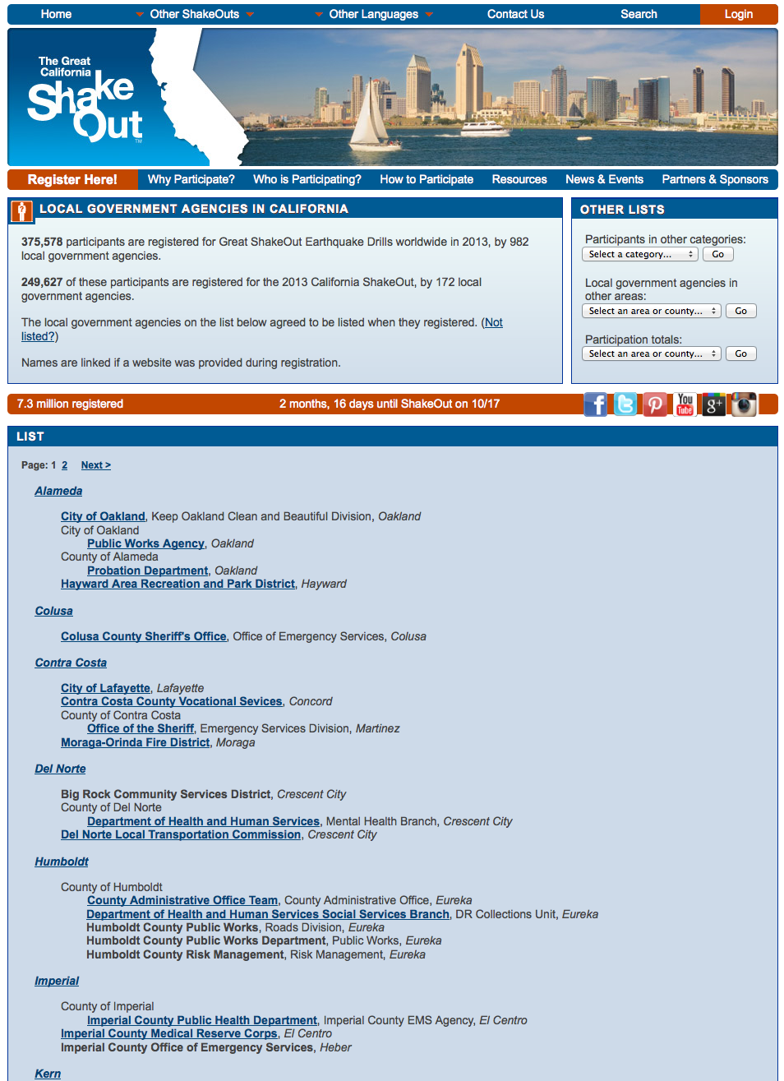
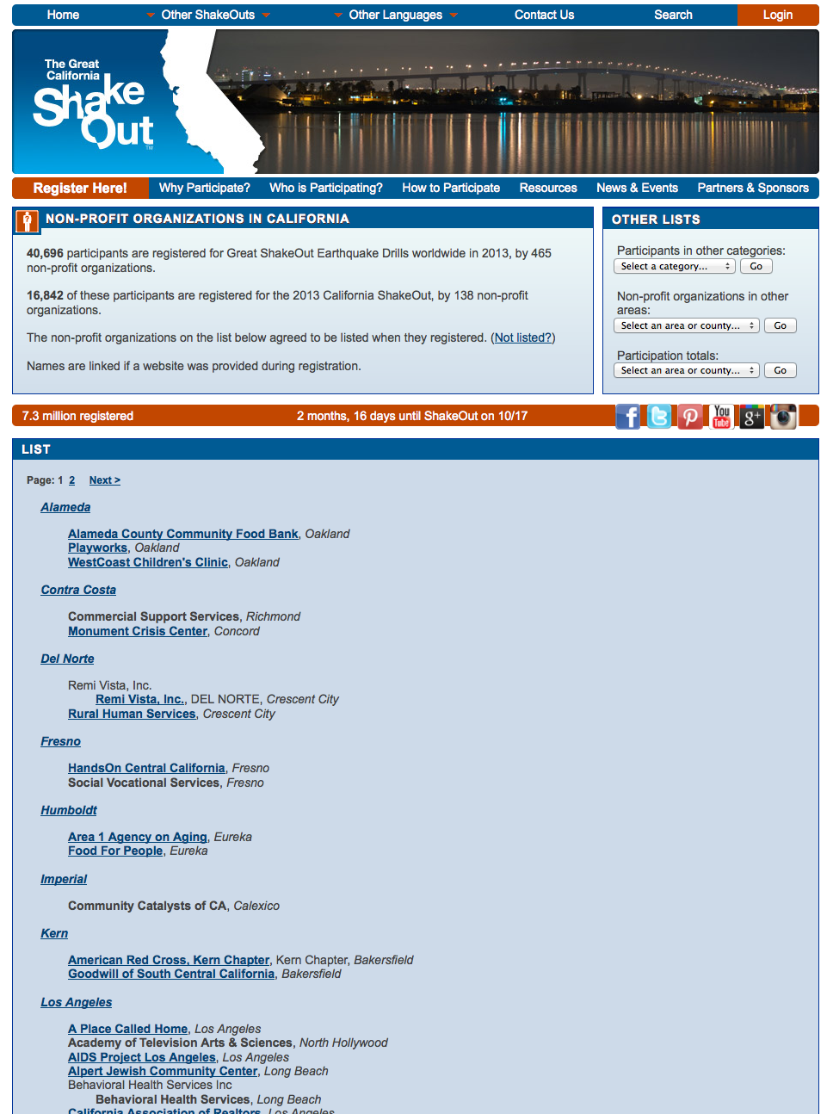

Slide 14
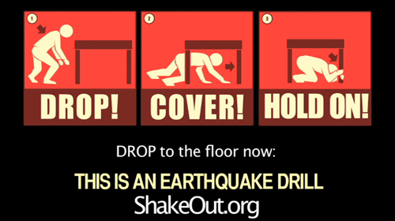
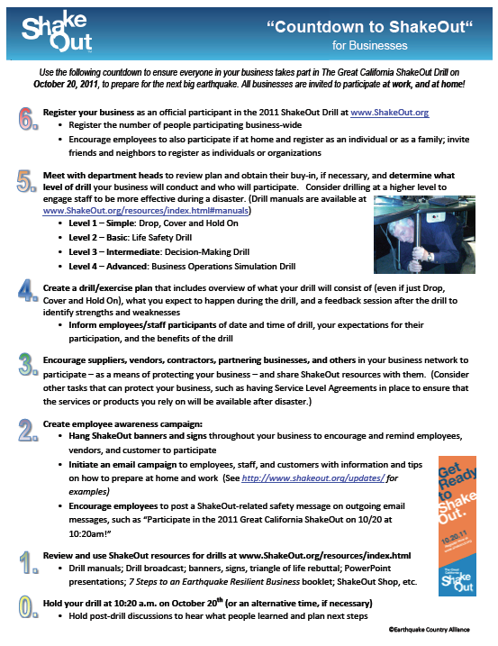
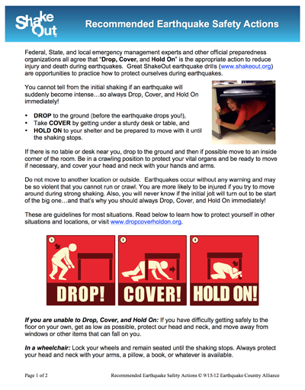
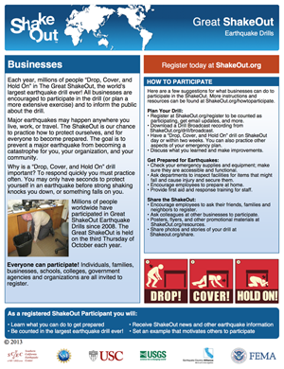
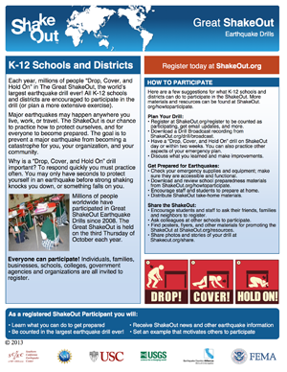
ShakeOut Resources

Slide 15
Register and Encourage Others
Register to participate at www.ShakeOut.org/california.
Use ShakeOut resources to educate your employees and the public about earthquake preparedness and safety (flyers, posters, manuals)
Use ShakeOut more than just for earthquake preparedness; combine with fire or other drills, replenish supplies, etc.
Encourage schools, districts, universities, businesses, government agencies (including local governments), and other large organizations to register.
Link to ShakeOut.org/california from your websites (web banner graphics on the Resources page)
Use social media to highlight your own drill plans and encourage others Invite the news media to cover your drill activities

Slide 16
Thank you!
Name
E-mail
Phone

