Slide 1
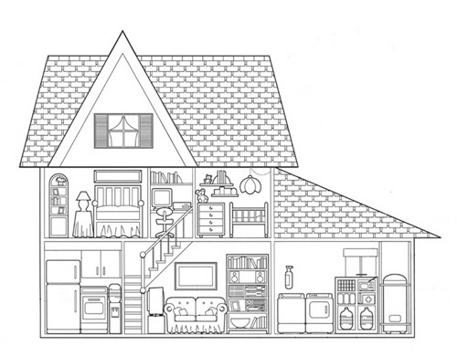
Home Safety
Outsmart the Quake!
Lesson 3
Identifying hazards and safety strategies

Slide 2
Home Safety
In this lesson you will learn about dangers an earthquake can cause in your home and safety strategies to reduce these dangers.
By the end of this lesson you will be able to:
Visually screen a room for earthquake dangers
Apply safety strategies to reduce these dangers

Slide 3
Photo by Nora Jagielo
Notes:
What dangers do you see in this bedroom?

Slide 4
Photo by Nora Jagielo
Notes:
Danger: Mirrors above bed
Safety Strategies:
Move mirrors to a different location.
Attach the mirror to the wall using a closed hook/security hanger or twist ties to attach the frame to the nail/screw.
Replace art above bed with soft art, such as a tapestry.

Slide 5
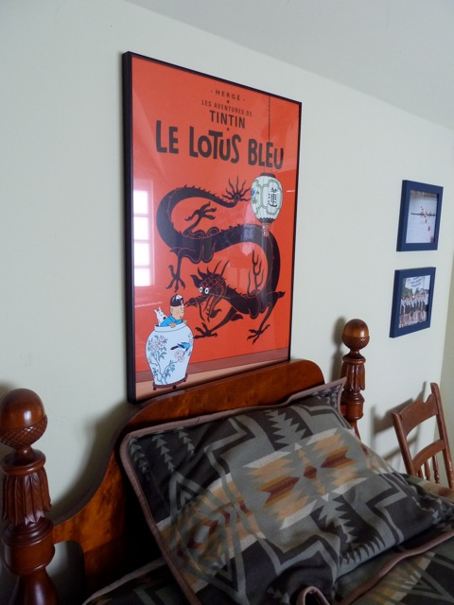
Photo by
Ryan Bainbridge
Notes:
What dangers do you see in this bedroom?

Slide 6
Photo by
Ryan Bainbridge
Notes:
Dangers: Heavy picture over bed, glass from picture frame.
Safety Strategies:
Move picture to a different location.
Attach the picture to the wall using a closed hook/security hanger or twist ties to attach the frame to the nail/screw.
Replace art above bed with soft art, such as a tapestry.

Slide 7
Photo by Nora Jagielo
Notes:
What dangers do you see in this living room?

Slide 8
Photo by Nora Jagielo
Notes:
Danger: pictures above couch, glass window and door.
Safety Strategies:
Move pictures to a different location.
Attach the pictures to the wall using a closed hook/security hanger or twist ties to attach the frame to the nail/screw.
Replace art above the couch with soft art, such as a tapestry.
Don’t have sitting areas located directly next to glass door/window.
Place a heavy curtain over windows to prevent the spread of shattered glass if they were to break.

Slide 9
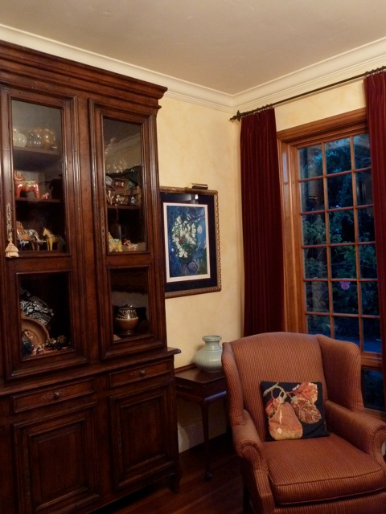
Photo by
Ryan Bainbridge
Notes:
What dangers do you see in this living room?

Slide 10
Photo by
Ryan Bainbridge
Notes:
Dangers: Tall heavy cabinet, glass from window, cabinet and painting;
Safety Strategies:
Attach the picture to the wall using a closed hook/security hanger or twist ties to attach the frame to the nail/screw.
Place a heavy curtain over windows to prevent the spread of shattered glass if they were to break.
Move heavy and breakable items in the cabinet to the lowest possible spot.
Use latches on cabinet doors to prevent items from falling out.
Use an adhesive such as sticky putty to attach items to the shelves.

Slide 11
Photo by Nora Jagielo
Notes:
What dangers do you see in this living room?

Slide 12
Photo by Nora Jagielo
Notes:
Dangers: Glass from windows and doors, bookshelf, books and decorations
Safety Strategies:
Attach the picture to the wall using a closed hook/security hanger or twist ties to attach the frame to the nail/screw.
Place a heavy curtain over windows to prevent the spread of shattered glass if they were to break.
Move heavy and breakable items in the cabinet to the lowest possible spot.
Use an adhesive such as sticky putty to attach items to the shelves.

Slide 13
Photo by Nora Jagielo
Notes:
What dangers do you see in this room?

Slide 14
Photo by Nora Jagielo
Notes:
Dangers: books and glass from windows
Safety Strategies:
Attach the picture to the wall using a closed hook/security hanger or twist ties to attach the frame to the nail/screw.
Place a heavy curtain over windows to prevent the spread of shattered glass if they were to break.
Move heavy and breakable items in the cabinet to the lowest possible spot.
Use an adhesive such as sticky putty to attach items to the shelves.

Slide 15
Discussion
What hazards are in your bedroom?
What could you do to eliminate those hazards?
Notes:
Have the students brainstorm earthquake hazards that are in their own bedroom. Give the students two minutes to write down as many hazards in their bedroom as possible. After two minutes, divide the students into small groups to discuss hazards in their bedrooms and safety strategies to lessen their danger.

Slide 16
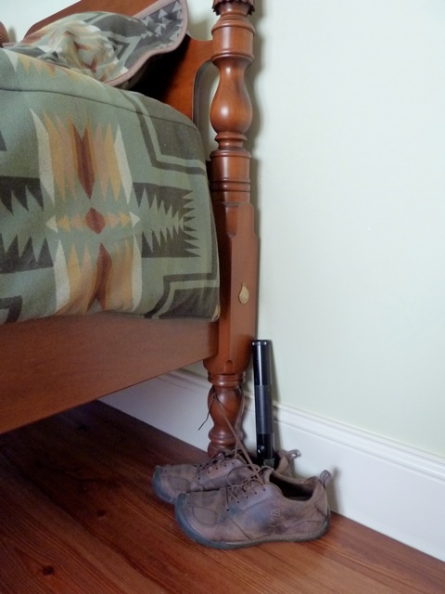
Attach shoes and a flashlight to bed
Notes:
When earthquakes happen while people are in bed, they often get out of bed with bare feet and step on broken glass as they walk around. Often, after earthquakes, the electrical system is damaged and the lights will not turn on.
An easy way to be more prepared for earthquakes that may happen at night is to keep an old pair of shoes and a flashlight by your bed. Tying your shoes and a flashlight to a leg of your bed, or placing them in a bag and tying that to a leg of your bed, will make sure the shoes do not slide across the room in the shaking. After the shaking stops, you will be able to reach down, untie the shoes, put them on and use the flashlight to more safely find your parents or evacuate your house.

Slide 17
Acknowledgements
Outsmart the Quake! lesson plans are intended to support 6th-8th grade student learning about disaster preparedness in conjunction with the Washington State ShakeOut drill. The lessons were developed in 2012 by Western Washington University students Nora Jagielo, Pamela Griswold, Spencer Andrich, Pat Chappelle and Ryan Bainbridge as part of the Disaster Risk Reduction Planning Studio.
If you have questions, comments or concerns, please contact Dr. Rebekah Green at Western Washington University’s Resilience Institute. Rebekah.green@wwu.edu.

