Slide 1
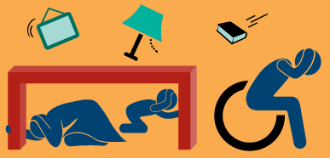
Great ShakeOut Earthquake Drills
Earthquakes are unpredictable and may happen where you live, work, or travel. Most injuries in earthquakes are from falling or flying objects.
Today we are joining millions of people worldwide who are practicing how to be safe during earthquakes

Slide 2
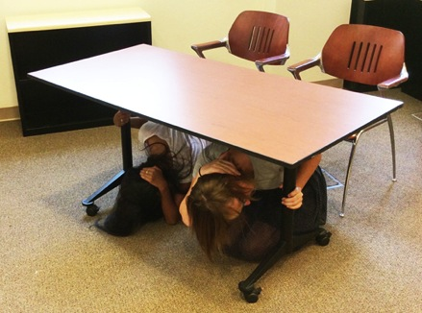
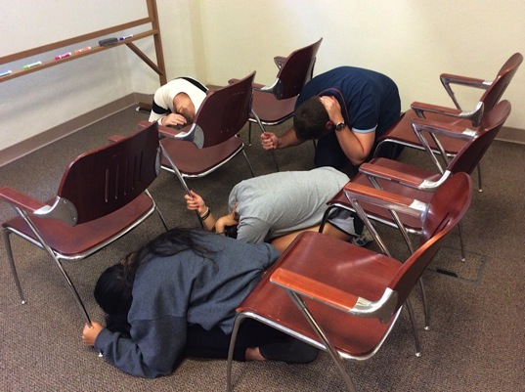
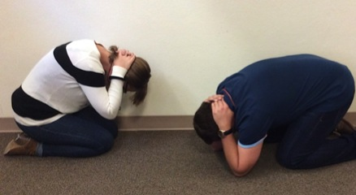
What Are We About To Do?
People get injured by falling objects and when they try to run, which is why we will practice Drop, Cover, and Hold On:
In a CLASSROOM OR AUDITORIUM:
Drop to the floor. Do not try to exit during shaking.
Cover your head and neck with one hand and seek shelter under your desk or table as best as possible. If in an auditorium with no tables, take cover between the rows of chairs.
Hold on to the leg of the desk/table with your other hand.
In a LABORATORY:
Step back from the lab table.
Drop to the floor on your knees next to a wall, away from glass and other hazards if possible.
Cover your head and neck with your hands and arms.
Hold On to something sturdy during the shaking
“Wait a Minute” after shaking stops. Then look around for hazards, including behind you, before getting up. Carefully exit the building if instructed.

Slide 3
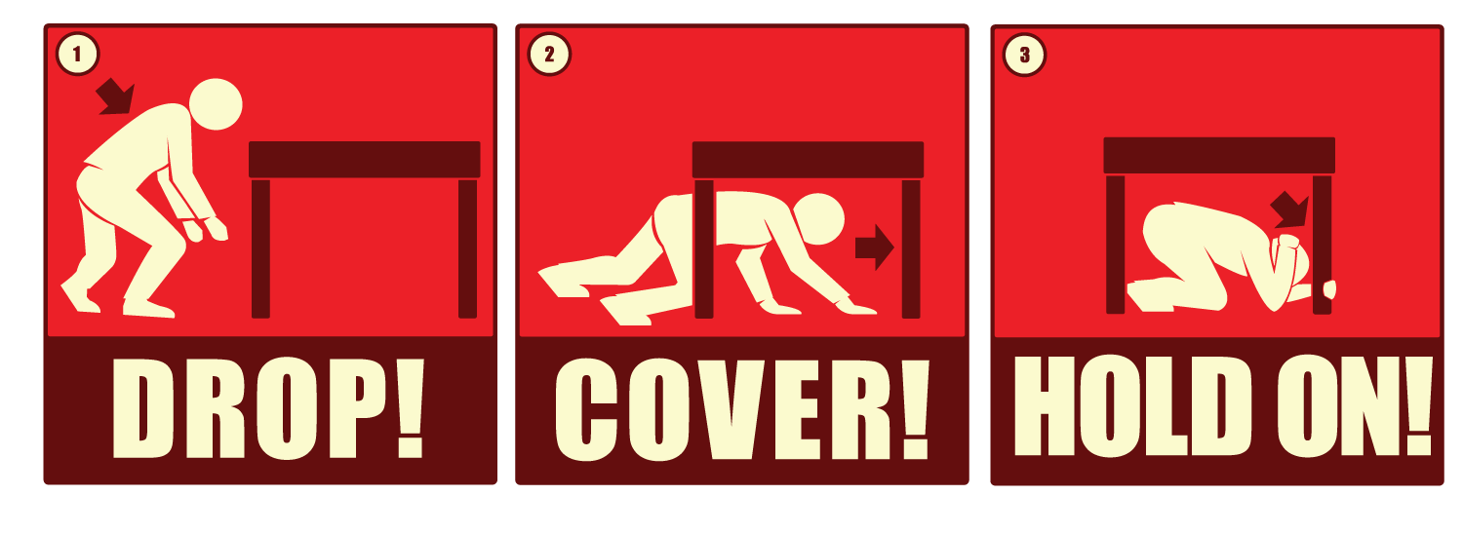
Time to ShakeOut!
ShakeOut 60-second Drill Narration (Click to Play)

Slide 4
Discussion Questions
If you were at home during an earthquake, what might fall on you? Can you move those items or secure them so they won’t cause injury?
Do you always keep your cell phone and computer charged? If you have a car, do you always keep the gas tank at least half full?
How would you contact your family in case of an emergency? Do you have a plan for checking in with one another and responding to emails/texts/etc.?
ATMs may be offline after a major earthquake. How long can you live on the money you have right now?
Do you know what “check in” services and hotlines are available for your use through our school?
Learn more at www.earthquakecountry.org

