Slide 1

2020 ShakeOut:
Earthquake Drills During COVID-19
Guidance for Grades K-4
(Distance Learning or In-Person Drills)
Great ShakeOut
Earthquake Drills

Slide 2
Drill Leader Instructions: Content and Resources
Total time for the activity will depend on the content you choose to include; the shortest time might be 10 minutes, but with discussion could be up to 20-30 minutes.
Delete or hide slides you will not use before your drill.
Visit www.ShakeOut.org/resources and www.ShakeOut.org/schools for materials and activities for use before your drill.
Visit www.EarthquakeCountry.org/step5
for self-protective guidance for various situations, and for why Drop, Cover, and Hold On is recommended.
CONTENT:
Drill Leader Instructions and earthquake safety resources
Pre-Drill Discussion (optional)
Great ShakeOut introduction
Overview of Drop, Cover, and Hold On, and other protective actions
Drill Narration options
(narration audio files and text)
Discussion for after drill (optional)

Slide 3


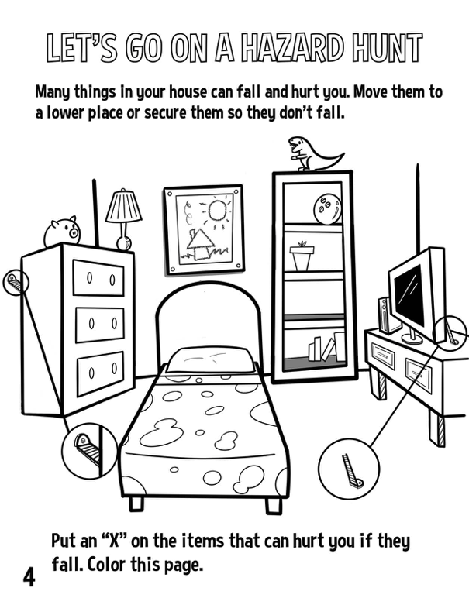


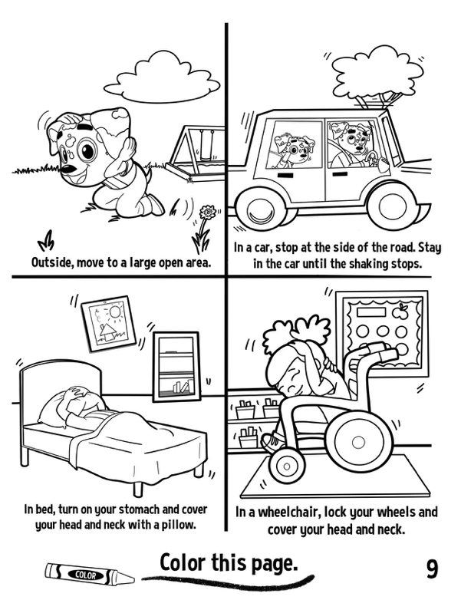
RocketRules.org: New materials for children age 4-9
English and Spanish Story Books
English, Spanish, Vietnamese, Chinese, and Tagalog
Notes:
Drill leaders: These materials are available for free download at RocketRules.org/earthquake; highly-quality printed versions pf the Story Books are also available for purchase at RocketRules.org/books.

Slide 4
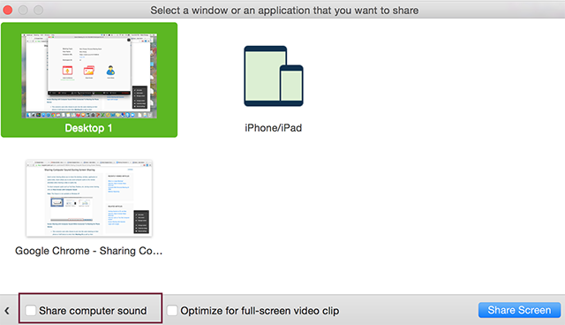
Drill Leader Instructions: Audio Settings
This PowerPoint includes a video and an audio recording of the ShakeOut “Drill Broadcast” narration.
For distance learning, when you share the slides you may need to set the option to “share computer sound” (this depends on your video conferencing service).
You should practice this in advance.
Settings for Zoom to share computer sound; other services may have similar settings.

Slide 5
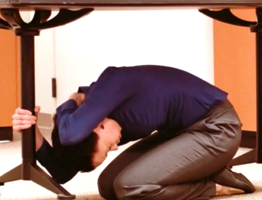
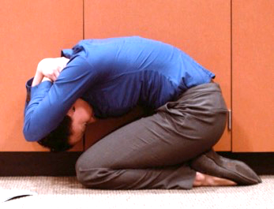
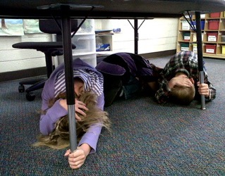
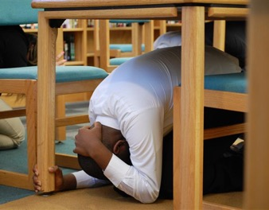
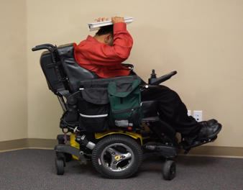
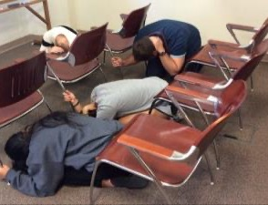
Great ShakeOut
Earthquake Drills
Notes:
(First slide for students)

Slide 6
Earthquake Experience
If you have felt an earthquake, what was it like?
What do we normally do at school for earthquake drills?
Why is practicing for earthquakes and other emergencies important?
What can we do before earthquakes to be prepared?
Notes:
(Optional slide)
Drill leader: Before the drill you can ask these basic questions about earthquake experience and preparedness (or add your own).

Slide 7
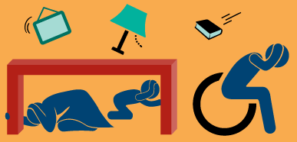
Great ShakeOut Earthquake Drill
Earthquakes may happen anytime and almost anywhere.
Most injuries caused by earthquakes are from falling or flying objects.
It is important to practice how to be safe!
Today we are joining millions of people
who are practicing earthquake safety!
Notes:
Drill leader: Visit www.ShakeOut.org to see the current number of participants in your area, for the entire U.S., and worldwide.

Slide 8
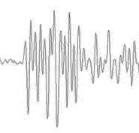
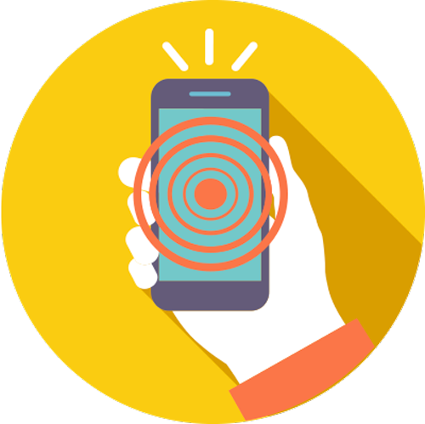

When Should You Protect Yourself?
When
You Feel Earthquake Shaking
When
You Get an Earthquake Alert
(California)
When
You Do an Earthquake Drill
Notes:
(Optional)
Drill leader: Public earthquake alerts are now available in California; in 2021 they will be available in Oregon and Washington too.
Learn more at ShakeAlert.org (entire West Coast) and Earthquake.ca.gov (Earthquake Warning California)

Slide 9
Be Safe During Earthquakes, Just like Rocket!
Notes:
Images courtesy The Hero in You Foundation

Slide 10
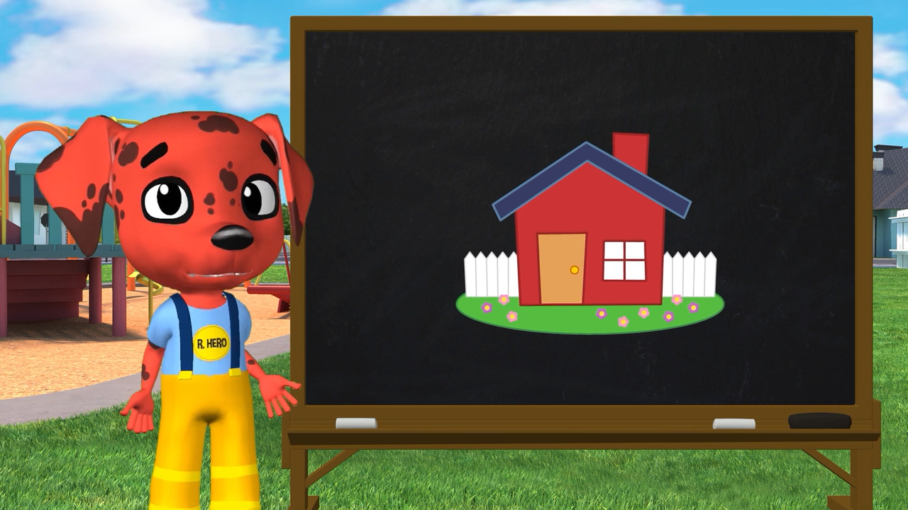
RocketRules.org Earthquake Safety Video (excerpt)
Notes:
Drill leader: Now play this video which teaches students what to do during the drill.
The full version of this video (5 minutes) is available at RocketRules.org/earthquakes.
Courtesy The Hero in You Foundation

Slide 11
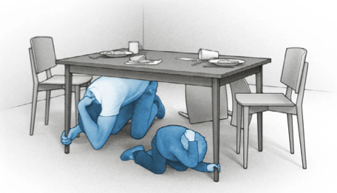
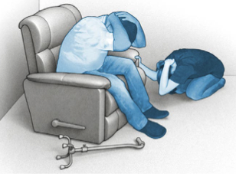
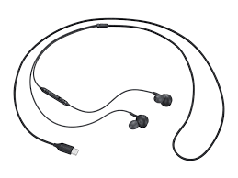
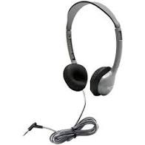
Drill Instructions
Be careful: this is about practicing safety, safely – not about being fast.
Distance Learning Drills:
  Tell your family or others nearby that you will be doing an earthquake drill. Invite them to practice with you.
  If you are using wired headphones, remove them now.
  Make sure you can hear instructions from your computer or tablet speaker.
Disconnect wired headphones
Notes:
Drill leader: The reason to remove wired headphones is so that computers or tablets are not pulled down when students drop to the floor.

Slide 12
Time to Practice, Just like Rocket!
Notes:
Images courtesy The Hero in You Foundation

Slide 13

Time to ShakeOut!
ShakeOut 60-second Drill Narration (no Sound Effects)
(Click speaker to Play)
Notes:
Drill leader: This is a recorded drill narration.
The next slide has the text of the recording if you want to read it to your students instead.
Before your drill, choose which version you will use, then delete or hide the slides you don’t need.

Slide 14
Time to ShakeOut!
This is an earthquake drill. Right now, DROP, COVER, AND HOLD ON.
DROP to the floor now. During a large earthquake, the ground might
jerk strongly and knock you down.
Take COVER under something sturdy, to protect yourself from objects that might be thrown across the room.
HOLD ON to your shelter until the shaking stops.
If you can’t get under something, stay low and protect your head and neck with your arms.
Now look around. What objects might fall or be thrown at you, that you should secure in place before a real earthquake?
Finally, a strong earthquake may generate a tsunami. If you're near the ocean during an earthquake, DROP, COVER, and HOLD ON, then quickly walk to high ground after the shaking stops.
This drill is over. Thank you for taking part in the Great ShakeOut!
Notes:
Drill leader: This is the text of the recording, if you prefer to read it yourself.

Slide 15
Discussion
What did you learn by practicing how to protect yourself?
Where are safer places in your home for when earthquakes happen?
What things might fall on you or others if a real earthquake happened right now?
Can these things be moved or secured so they won’t fall?
How would you contact your family or others?
Communicating via text or apps may be possible when calls are not
What should you have in a disaster supplies kit?
Notes:
Drill leader: You can choose which questions to ask or delete some depending on available time.
Learn more: Ready.gov or EarthquakeCountry.org/sevensteps

