Slide 1
Great ShakeOut Earthquake Drills
Drill Guidance for
Grades K-4
(Distance Learning or In-Person)

Slide 2
Drill Leader Instructions: Content and Resources
CONTENT:
Drill Leader Instructions and earthquake safety resources
Pre-Drill Discussion (optional)
Great ShakeOut introduction
Overview of Drop, Cover, and Hold On, and other protective actions
Drill Narration options (narration audio files and text)
Discussion for after drill (optional)
Total time for the activity will depend on the content you choose to include; the shortest time might be 10 minutes, but with discussion could be up to 20-30 minutes.
Delete or hide slides you will not use before your drill.
Visit ShakeOut.org/resources and ShakeOut.org/schools for materials and activities for use before your drill.
Visit EarthquakeCountry.org/step5 for self-protective guidance for various situations, and for why Drop, Cover, and Hold On is recommended.

Slide 3
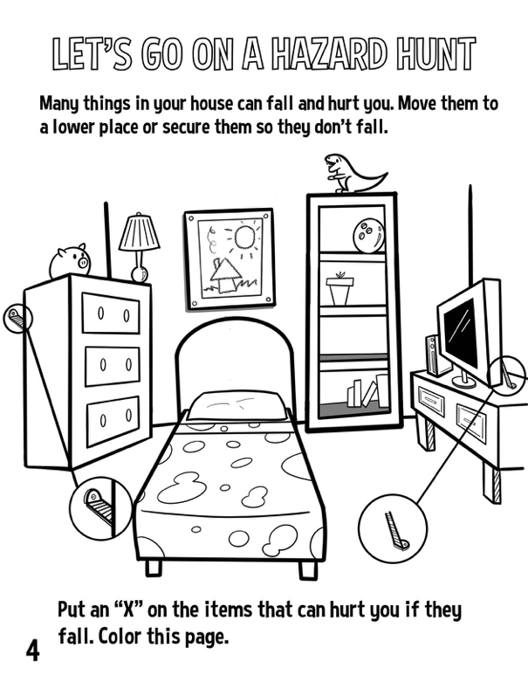
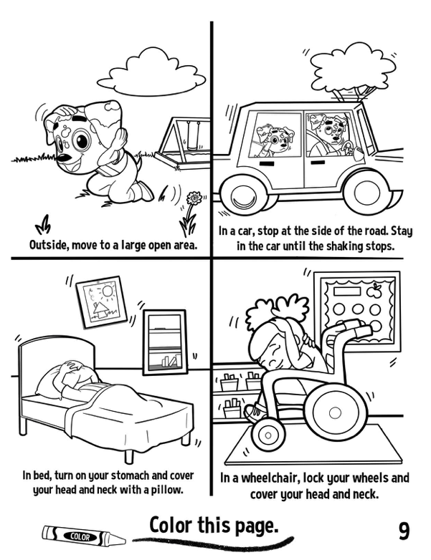
RocketRules.org/earthquakes: Materials for children age 4-9
Story Books in English and Spanish
Activity Books in Many Languages
Notes:
Drill leader: These materials are available for free download at RocketRules.org/earthquake; high-quality printed versions of the Story Books are also available for purchase at RocketRules.org/books.

Slide 4
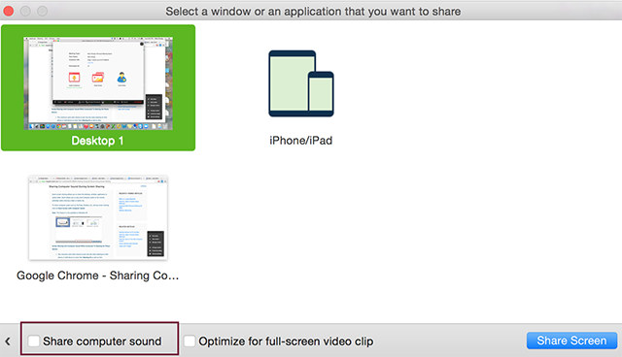
Drill Leader Instructions: Audio Settings
This PowerPoint includes a video and an audio recording of the ShakeOut “Drill Broadcast” narration.
For distance learning, when you share the slides, you may need to set the option to “share computer sound” (this depends on your video conferencing service).
You should practice this in advance
Settings for Zoom to share computer sound; other services may have similar settings.

Slide 5
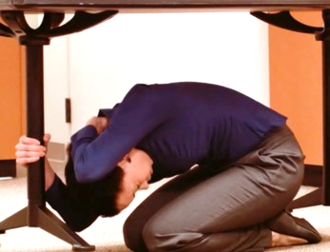
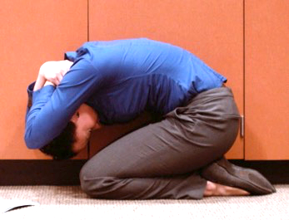
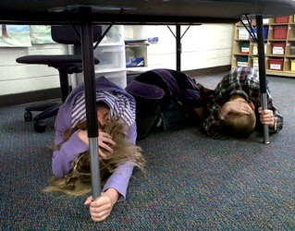
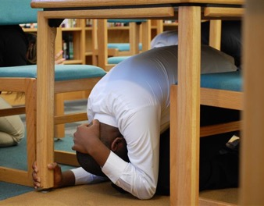
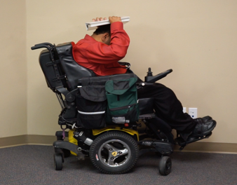
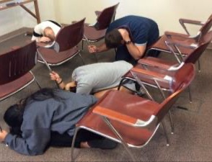
Great ShakeOut Earthquake Drills
Notes:
This is the first slide to show participants

Slide 6
Earthquake Experience
Have you felt an earthquake? What was it like?
What do we do at school during earthquake drills?
Why is practicing for earthquakes and other emergencies important?
What can we do before earthquakes to be prepared?
Notes:
(Optional slide) Drill leader: Before the drill you can ask these basic questions about earthquake experience and preparedness (or add your own).

Slide 7
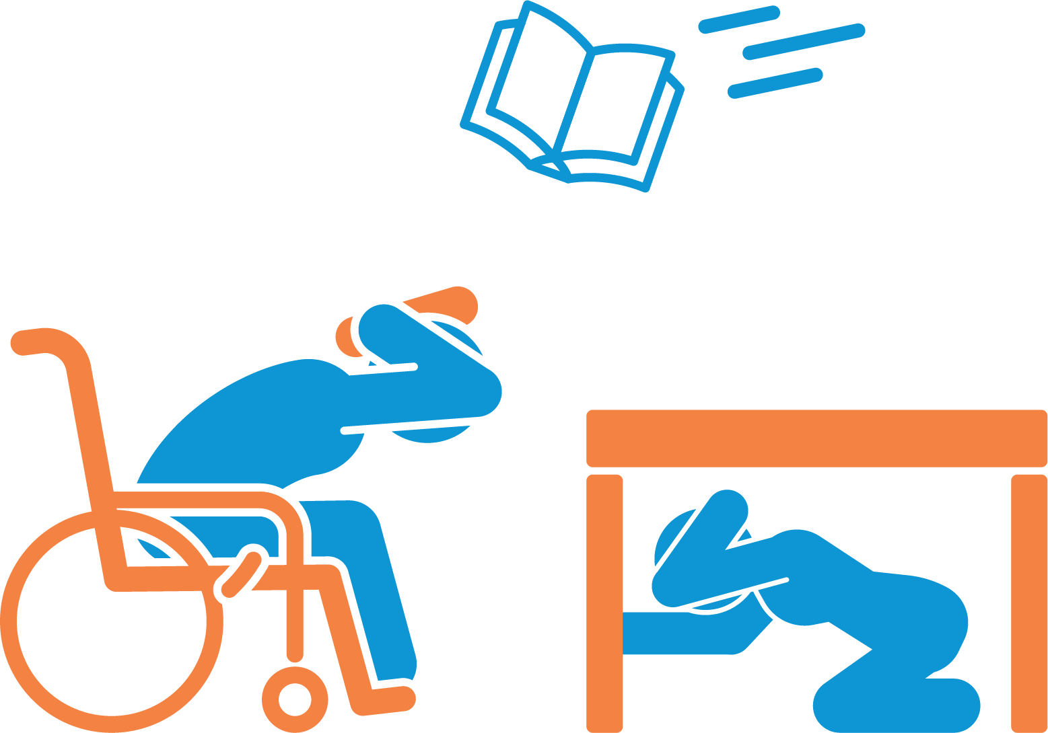
Great ShakeOut Earthquake Drill
Earthquakes may happen anytime and almost anywhere.
Most injuries caused by earthquakes are from falling or flying objects.
It is important to practice how to be safe!
Today we are joining millions of people
who are practicing earthquake safety!
Notes:
Drill leader: Visit ShakeOut.org to see the current number of participants in your area, for the entire U.S., and worldwide.

Slide 8
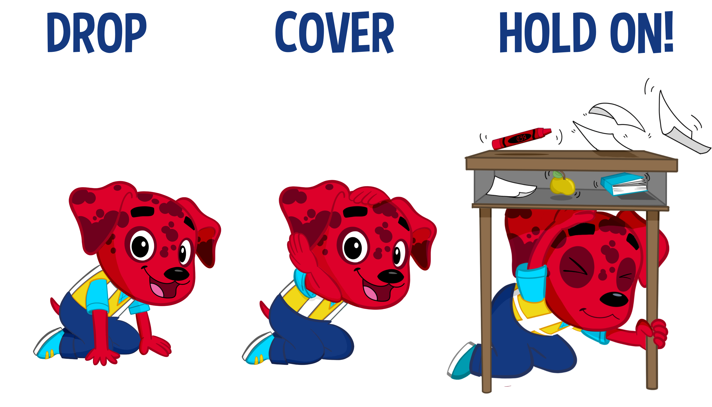
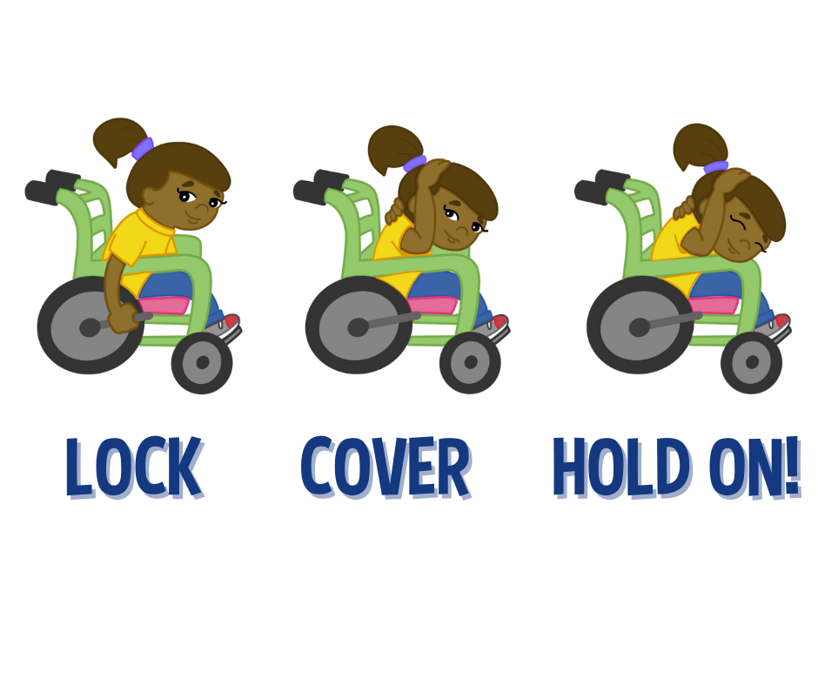
Be Safe During Earthquakes…
Notes:
Images courtesy of The Hero in You Foundation

Slide 9
Notes:
Drill leader: Now play this video which teaches students what to do during the drill.
If the video doesn’t play within the , download it at https://drive.google.com/file/d/1rwxsbZRnPesykvUvQTcuXS6e8JzTwSNc/view?usp=sharing
The full version of this video (5 minutes) is available at RocketRules.org/earthquakes.
Courtesy The Hero in You Foundation

Slide 10
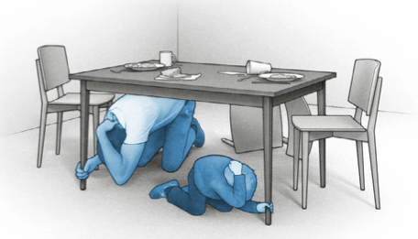
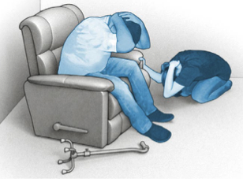
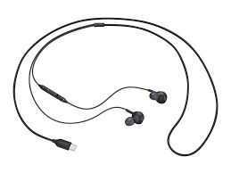
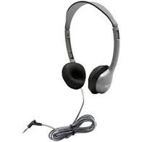
Drill Instructions
Be careful: this is about practicing safety, safely – not about being fast.
Distance Learning Drills:
Tell your family or others nearby that you will be doing an earthquake drill. Invite them to practice with you.
If you are using wired headphones, remove them now.
Make sure you can hear instructions from your computer or tablet speaker.
Disconnect wired headphones
Notes:
Drill leader: The reason to remove wired headphones is so that computers or tablets are not pulled down when students drop to the floor.

Slide 11
Time to Practice!
Notes:
Images courtesy of The Hero in You Foundation

Slide 12
Time to ShakeOut!
ShakeOut 60-second Drill Narration (no Sound Effects)
(Click speaker or to play)
Notes:
Drill leader: This is a recorded drill narration.
The next slide has the text of the recording if you want to read it to your students instead of playing this recording.
If the narration does not play when the speaker is clicked, download or play the narration using this link: https://www.shakeout.org/downloads/broadcast/universal/ShakeOutDrillBroadcastEnglish_NoSoundEffects.mp3
Before your drill, choose which version you will use, then delete or hide the slides you don’t need

Slide 13
Time to ShakeOut!
This is an earthquake drill. Right now, DROP, COVER, AND HOLD ON.
DROP to the floor now. During a large earthquake, the ground might jerk strongly and knock you down.
Take COVER under something sturdy, to protect yourself from objects that might be thrown across the room.
HOLD ON to your shelter until the shaking stops.
If you can’t get under something, bend over and protect your head and neck with your arms.
Now look around. What objects might fall or be thrown at you, that you should secure in place before a real earthquake?
Finally, a strong earthquake may generate a tsunami. If you're near the ocean during an earthquake, DROP, COVER, and HOLD ON, then quickly walk to high ground after the shaking stops.
This drill is over. Thank you for taking part in the Great ShakeOut!
Notes:
Drill leader: This is the text of the recording, if you prefer to read it yourself.
The preious slide has a recording of this script if you want to play it foryour students instead of reading this text.
Before your drill, choose which version you will use, then delete or hide the slides you don’t need

Slide 14
Discussion
What did you learn by practicing how to protect yourself?
Where are safer places in your home for when earthquakes happen?
What things might fall on you or others if a real earthquake happened right now?
What should you have in a disaster supplies kit?
Notes:
Drill leader: You can choose which questions to ask or delete some depending on available time.
#3 extra question: Can these things be moved or secured so they won’t fall?
Learn more: Ready.gov or EarthquakeCountry.org/sevensteps

