Slide 1

Great ShakeOut Earthquake Drills
Drill Guidance for
Higher Education
(Distance Learning or In-Person)

Slide 2
Drill Leader Instructions: Content and Resources
CONTENT:
Drill Leader Instructions and earthquake safety resources
Pre-Drill Discussion (optional)
Great ShakeOut introduction
Overview of Drop, Cover, and Hold On, and other protective actions
Drill Narration options
(narration audio files and text)
Discussion for after drill (optional)
Total time for the activity will depend on the content you choose to include; the shortest time might be 10 minutes, but with discussion could be up to 20-30 minutes.
Delete or hide slides you will not use before your drill.
Visit ShakeOut.org/resources and ShakeOut.org/highereducation for materials and activities for use before your drill.
Visit EarthquakeCountry.org/step5 for self-protective guidance for various situations, and for why Drop, Cover, and Hold On is recommended.

Slide 3
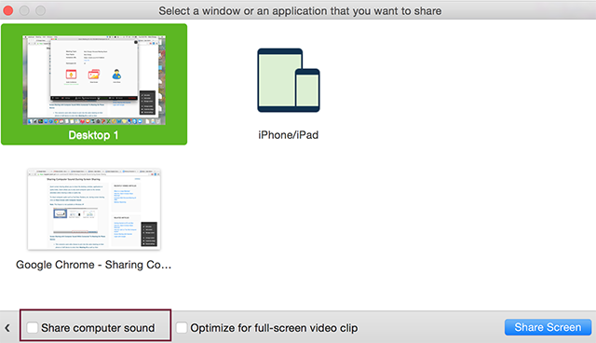
Drill Leader Instructions: Audio Settings
This PowerPoint includes a video and an audio recording of the ShakeOut “Drill Broadcast” narration.
For distance learning, when you share the slides, you may need to set the option to “share computer sound” (this depends on your video conferencing service).
You should practice this in advance
Settings for Zoom to share computer sound; other services may have similar settings.

Slide 4
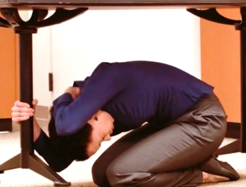
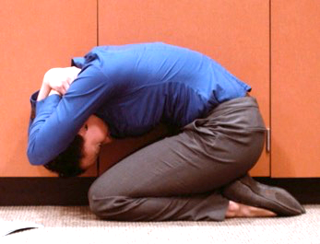
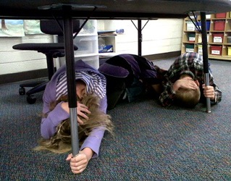
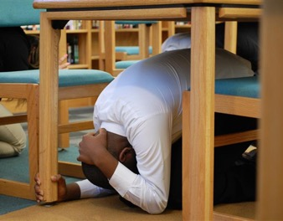
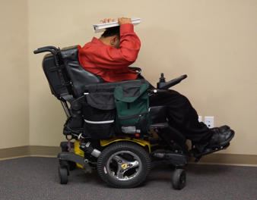
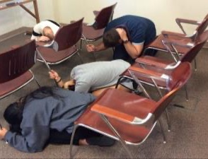
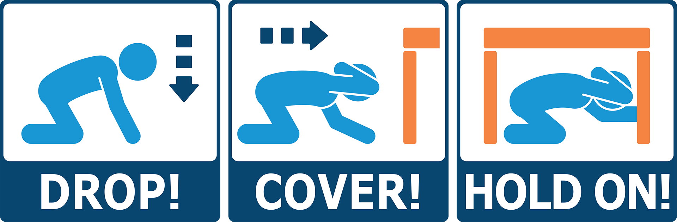
Great ShakeOut
Earthquake Drills
Notes:
This is the first slide to show participants

Slide 5
Earthquake Experience
If you have felt an earthquake, what was it like?
What do we normally do at school for earthquake drills?
Why is practicing for earthquakes and other emergencies important?
What can we do before earthquakes to be prepared?
Notes:
(Optional slide) Drill leader: Before the drill you can ask these basic questions about earthquake experience and preparedness (or add your own).

Slide 6
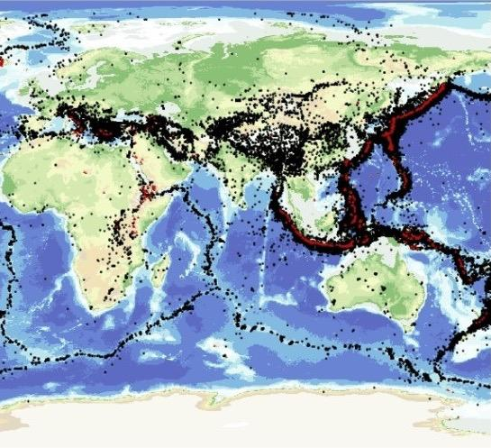
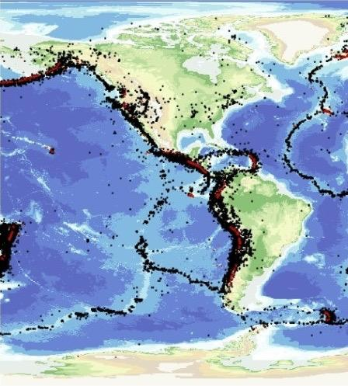
Global Earthquakes
Notes:
(Optional slide) Earthquakes happen all over the world, but especially along edges of the Earth’s tectonic plates (such as the West Coast of North America).

Slide 7
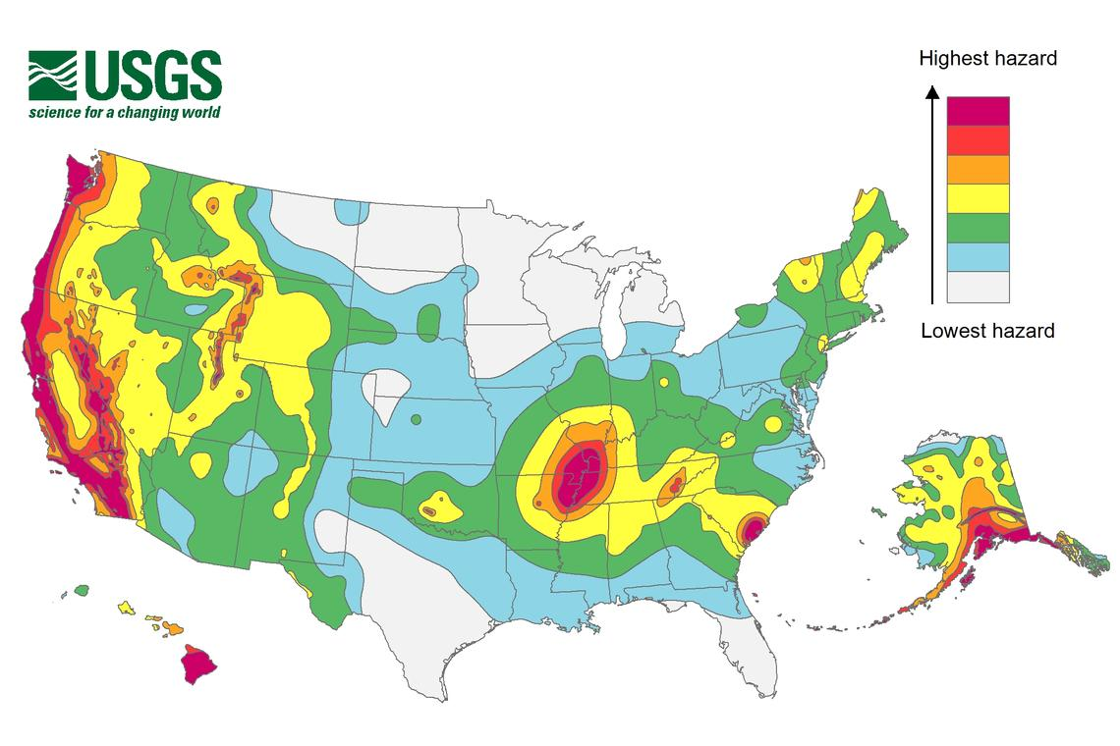
U.S. Earthquake Shaking Hazards
Notes:
(Optional slide) The U.S. Geological Survey estimates that shaking intensity and frequency is highest in:
California, Oregon, Washington, Alaska, Hawaii, the Central U.S., and South Carolina.
However, every state can have earthquakes or feel shaking caused by earthquakes in other states.
It’s important to know how to be safe where we live, but also where we may travel and experience earthquakes.

Slide 8
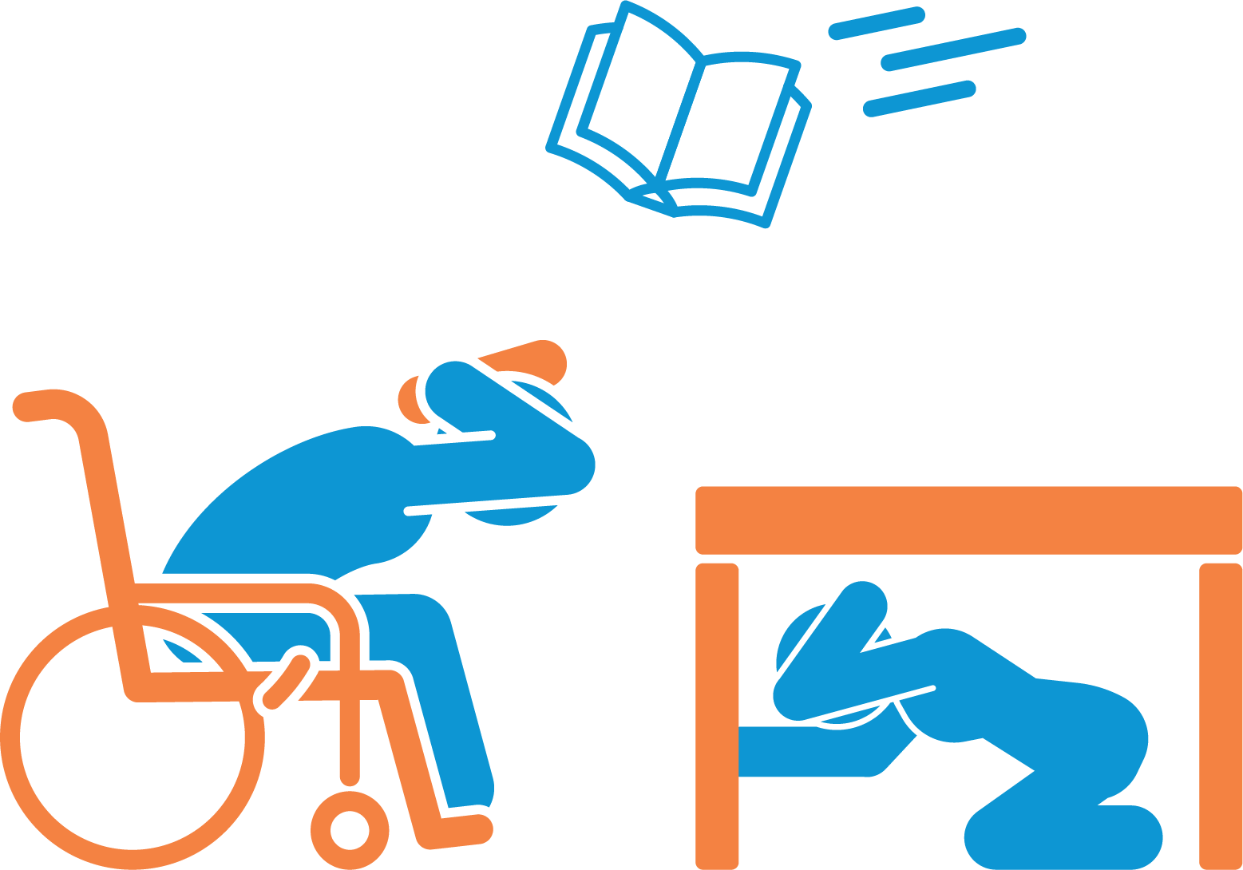
Great ShakeOut Earthquake Drill
Earthquakes may happen
anytime and almost anywhere.
Most injuries caused by earthquakes
are from falling or flying objects.
It is important to practice how to be safe!
Today we are joining millions of people
who are practicing earthquake safety!
Notes:
Drill leader: Visit ShakeOut.org to see the current number of participants in your area, for the entire U.S., and worldwide.

Slide 9

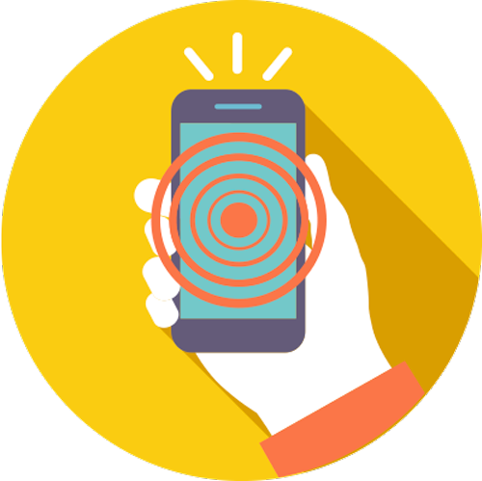
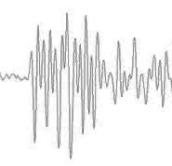
When Should You Protect Yourself?
When
You Feel Earthquake Shaking
When
You Get an Earthquake Alert
(West Coast)
When
You Do an Earthquake Drill
Notes:
(Optional slide) Drill leader: Public earthquake alerts are now available in California (Oregon and Washington will be available soon).
Learn more at ShakeAlert.org (entire West Coast) and Earthquake.ca.gov (Earthquake Warning California)

Slide 10

If a Table or Desk is Nearby
Drop where you are,
onto your hands and knees.
Cover your head and neck
with one arm and hand.
Then crawl underneath the table or desk
for additional shelter.
Stay on your knees and bend forward
to protect vital organs.
Hold On to your shelter with one hand.
Keep covering your head/neck with your other hand.
Notes:
Drill leader: Read the text; the next slide is if there is nothing to get under.

Slide 11
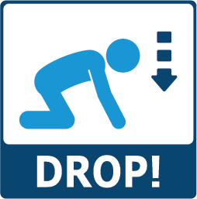



If There is Nothing to Get Under
Drop where you are,
onto your hands and knees.
Cover your head and neck
with one arm and hand.
Then crawl next to a wall,
away from any windows.
Stay on your knees and bend forward
to protect vital organs
Hold On to your shelter with one hand.
Keep covering your head/neck with your other hand.
Notes:
Drill leader: The purpose of getting next to a wall is so objects that may fly or fall can only hit you from one side.

Slide 12

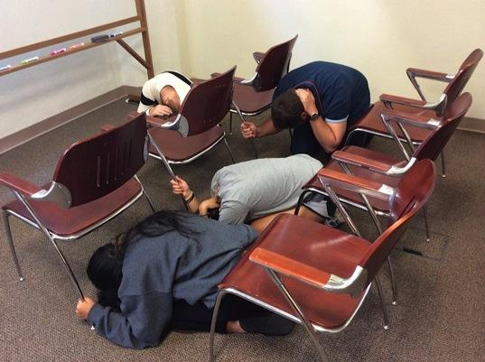
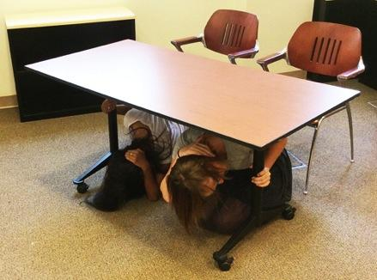
If in a Classroom, Auditorium or Laboratory
In a CLASSROOM OR AUDITORIUM:
Drop to the floor where you are.
Cover your head and neck with one arm/hand.
Nearby tables or desks: crawl underneath and Hold On to your shelter with your free hand.
Rows of chairs: get between the rows and Hold On to a chair with your free hand.
Alternative: get next to a wall with no windows and cover your head and neck with both arms/hands.
In a LABORATORY:
Step back from the lab table.
Drop to the floor on your knees next to a wall, away from glass and other hazards if possible.
Cover your head and neck with your hands and arms.
Hold On to something sturdy if possible.
Notes:
Drill leader: Classrooms, auditoriums, laboratories, etc. can have very distinct layouts. Participants should consider how best they can protect themselves from falling of flying objects in these spaces.

Slide 13
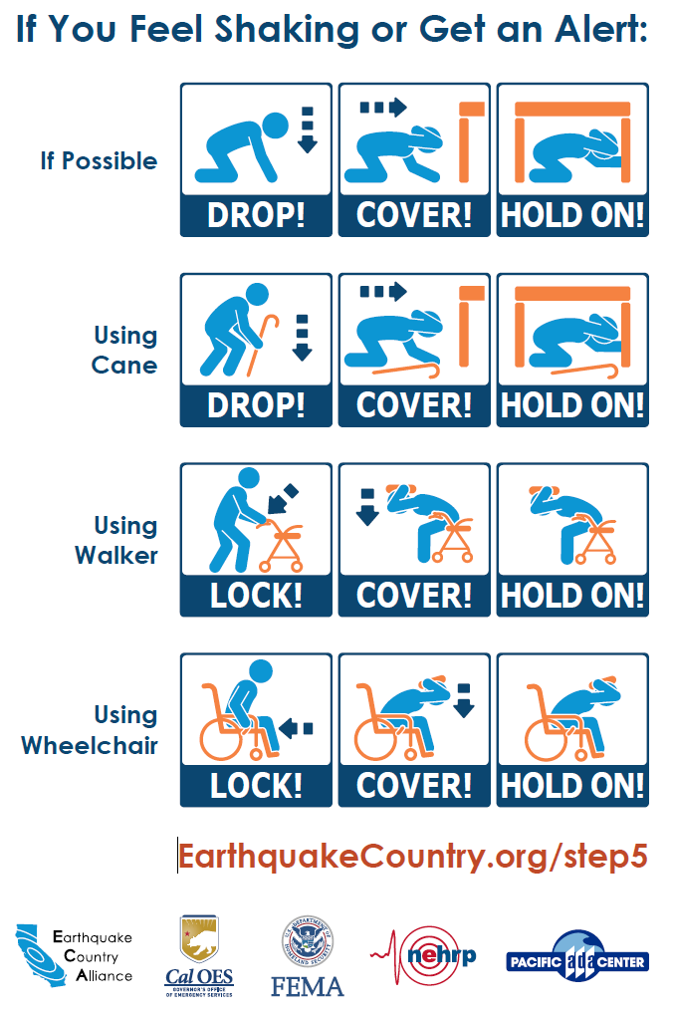
Adapt for Your Situation
If you cannot get back up again by yourself, do not drop to the ground.
If using a wheelchair or walker,
lock the wheels (or set the brake).
Bend over and cover your head and neck with your arms/hands. You can also hold on to a book or other object over your head.
Instruct others how to assist you.
Notes:
Drill leader: Guidance for many situations is at ShakeOut.org/dropcoverholdon

Slide 14
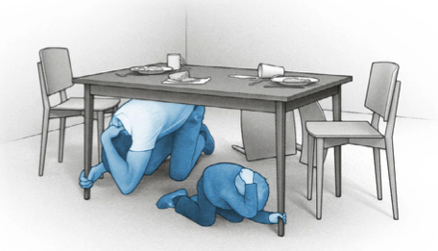
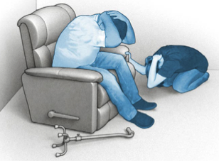
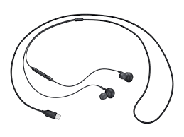
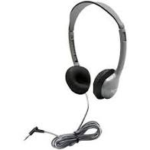
Drill Instructions
Be careful: this is about practicing safety, safely – not about being fast.
Distance Learning Drills:
  Tell your family or others nearby that you will be doing an earthquake drill. Invite them to practice with you.
  If you are using wired headphones, remove them now.
  Make sure you can hear instructions from your computer or tablet speaker.
Disconnect wired headphones
Notes:
Drill leader: The reason to remove wired headphones is so that computers or tablets are not pulled down when students drop to the floor.

Slide 15

Time to ShakeOut!
ShakeOut 60-second Drill Narration (with Sound Effects)
(Click speaker to Play)
Notes:
Drill leader: This version has drill narration and messaging, plus rumbling/shaking sounds, breaking glass, sirens, etc.
If the narration does not play when the speaker is clicked, download or play the narration using this link: https://www.shakeout.org/downloads/broadcast/universal/ShakeOutDrillBroadcastEnglish.mp3
The next slide has the narration only, followed by a slide with the text of the recording if you want to read it to your students instead.
Before your drill, choose which version you will use, then delete or hide the slides you don’t need.

Slide 16

Time to ShakeOut!
ShakeOut 60-second Drill Narration (no Sound Effects)
(Click speaker to Play)
Notes:
Drill leader: This version has drill narration only.
If the narration does not play when the speaker is clicked, download or play the narration using this link: https://www.shakeout.org/downloads/broadcast/universal/ShakeOutDrillBroadcastEnglish_NoSoundEffects.mp3
Before your drill, choose which version you will use, then delete or hide the slides you don’t need.

Slide 17
Time to ShakeOut!
This is an earthquake drill. Right now, DROP, COVER, AND HOLD ON.
DROP to the floor now. During a large earthquake, the ground might
jerk strongly and knock you down.
Take COVER under something sturdy, to protect yourself from objects that might be thrown across the room.
HOLD ON to your shelter until the shaking stops.
If you can’t get under something, bend over and protect your head and neck with your arms.
Now look around. What objects might fall or be thrown at you, that you should secure in place before a real earthquake?
Finally, a strong earthquake may generate a tsunami. If you're near the ocean during an earthquake, DROP, COVER, and HOLD ON, then quickly walk to high ground after the shaking stops.
This drill is over. Thank you for taking part in the Great ShakeOut!
Notes:
Drill leader: This is the text of the recording, if you prefer to read it yourself.
Before your drill, choose which version you will use, then delete or hide the slides you don’t need.

Slide 18
Discussion
What did you learn by practicing how to protect yourself?
What might fall on you or others if a real earthquake happened now right now? How might you move or secure those items so they won’t cause injury?
If power goes out in your area for several days or more, how long will cell phone batteries last? Do you or your family have a “powerbank” charger for phones?
How would you contact your family or others? Communicating via text or apps may be possible when calls are not
What should you have in a disaster supplies kit?
Learn more: Ready.gov or EarthquakeCountry.org/sevensteps
Notes:
Drill leader: You can choose which questions to ask or delete some depending on available time.
#3 extra question: Can these things be moved or secured so they won’t fall?
#4 option: Communicating via text or apps may be possible when calls are not
Learn more: Ready.gov or EarthquakeCountry.org/sevensteps

