Slide 1


The Day After The Shakeout
Place your Counties Logo Here
Tabletop Exercise

Slide 2
Room Breakout
Law Enforcement
EMS/Medical
Media/Press
Local Business
Fire
Public
Elected
Officials

Slide 3
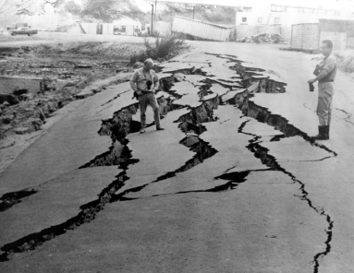
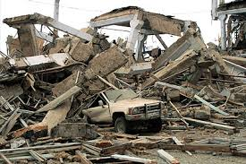
Background
Each time an earthquake occurs in Montana, the news media and public asks, “Does Montana have earthquakes?” Short answer: Yes!
In comparison with California, Nevada, and Utah, major earthquakes here are infrequent. But each year, hundreds of earthquakes do occur in and around Montana. Taking steps now to prepare your family and home will help mitigate the effects of moderate to severe earth shaking.
One important result of the Day after the ShakeOut is that the key to recovery in any community lies with infrastructure: the essential facilities like roads, hospitals and dams; and the lifelines that supply water, power, gas, and communication. The more damage there is to infrastructure, the slower the recovery.
That is exactly what this short exercise is designed to address

Slide 4
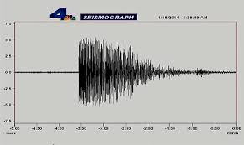
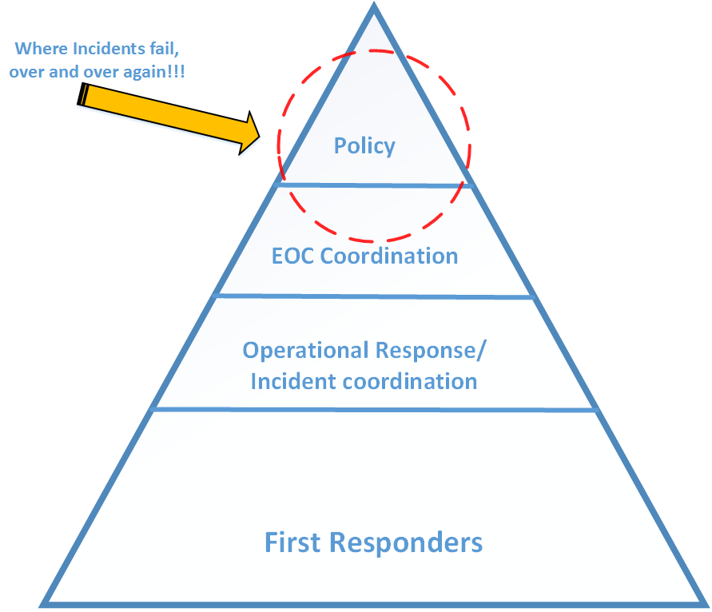
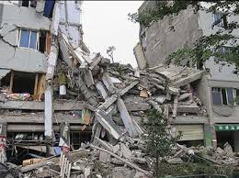
Purpose
To evaluate the response and recovery efforts the day after an earthquake impacts your jurisdiction.
To formulate a plan that addresses the communities response through information sharing and gathering to further create a community level of situational awareness

Slide 5
Goals
Educate the decision makers within the jurisdiction to the effect of an earthquake within the region and the response/recovery responsibilities associated with the incident
Define the roles and responsibilities within the jurisdiction for earthquake response/recovery
Provide all aspects of public information to the communities
Provide and assess levels of damage for decision makers

Slide 6
Objectives/ Core Capabilities
Education of Elected Officials |  | Planning, Operational Coordination, Intelligence and info sharing, community resilience, Long-Term vulnerability reduction, R&D Resilience assessment, Threats & Hazard ID, Economic Recovery,
Define roles and responsibilities of IC in community |  | Planning, Operational Coordination, Intelligence and info sharing, Threats & Hazard ID, operation communications
Clarify ICS structure |  | Operation coordination, operation communications
Provide Public Information & warning |  | Intelligence and info sharing, community resilience,
Create Community Awareness |  | Intelligence and info sharing, community resilience,
Understanding the management of incident resources |  | Operation coordination, operation communications,
Identify public health issues |  | Protect, prevention, operational coordination, health & social services, threat & hazard identification.
Economic Recovery |  | Recovering, supply chain,

Slide 7
Situation 1.
You just had an earthquake in your jurisdiction (5.2 magnitude) that has created some structural damage (roads and buildings) roughly 24 hours ago. There have been spot power outages, no causalities and those who have been injured have all been identified. Sewer and Water damages have not been assessed as of yet.
Transportation lines must be assessed, back up generators and temporary cell sites along with assessment of damage on City and County buildings. Small spot fires have been occurring, and an overall status of the infrastructure is not know . Public buildings have been affected and are not cleared for returning to normal daily business.

Slide 8
Questions for Situation 1.
Who’s in Charge of the response & recovery ?
Do we know how many people are displaced ?
What is the initial damage assessment ?
Location of shelters (identified) ?
Secondary EOC identified ?
Infrastructure assessment, who does it ?
Schools & Daycare assessment, who does it ?
Do we need to declare an emergency or a disaster ?

Slide 9
Situation 2.
It has been determined that water is not potable. A plan has been developed for water distribution and monitoring.
An announcement is being formulated for public release through electronic, social media and print media.
An initial damage assessment has been completed. The county courthouse is not safe to return to, however, is expected to be cleared with 48 hours. Local schools and the hospital are being evaluated and an estimate on their availability for use will come today.

Slide 10
Questions for Situation 2.
How long until the water is going to be usable?
What key items need to be in the message to the public about the water ?
Where will (county business) be conducted and supported out of over the next 2-3 days ?
Who will pay for clean up and debris removal? Is this just city/county property or all common areas ?
Is there a plan for clean up and is it included in the EOP, or should it be included ?

Slide 11
Situation 3.
It is now 48 hours after the event (Earthquake)
90% of the power has been restored to the County, the Courthouse has been evaluated and restored to service.
The schools, daycares and hospital have been evaluated and restored to service.
State disaster declaration has been approved
Debris removal plan has been implemented

Slide 12
Questions for Situation 3.
Is there a need for long term study to determine the effect on local infrastructure ?
Should we conduct an After Action Report for the incident ?
Is there a need for CISM debriefing ?
Was our media plan effective to communicate to the population what we needed to communicate ?

Slide 13
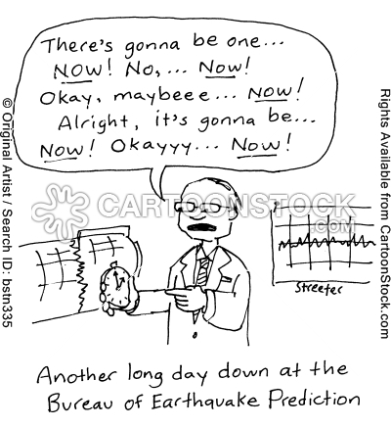
Conclusion
Be patient with each other and yourself
Try not to judge things or make important decisions when feeling low.
Build routines
Take stock of what you have learned and how you have changed
Remember what was important before the disaster
Talk things over with others who are interested
Think how you would like life to be in the future
Give attention to what has been neglected – relationships, recreation, family, leisure and private time
Look for opportunity to share your stories
Think about positive ideas and plans.
Try to focus on what you can influence and not let your peace of mind depend on what others do.

Slide 14
Hotwash
What did we learn from the exercise?
What did we do well?
What can we do better?
How will we address what we learned? (who is going to take action?)
When will we revisit the identified issues again? ( Where ?)

Slide 15
Thank You for Participating
Please remember to plan early for the 2015 Great Montana Shakeout

