Slide 1
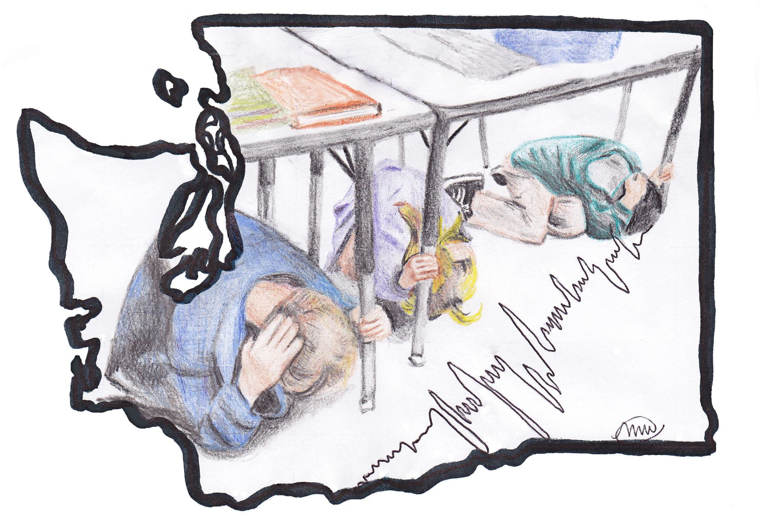
Protect yourself
Image by Megan Waddell
Outsmart the Quake! Lesson 2
Staying safe in school

Slide 2
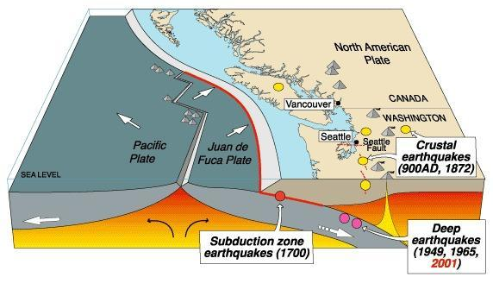
Three Types of Earthquakes in Western Washington
Subduction zone earthquakes
Deep earthquakes
Shallow fault earthquakes
http://www.ouramazingplanet.com/1694-cascadia-fault-earthquake-monitors.html
Notes:
Three types of earthquakes can occur in Western Washington: subduction, deep, and shallow. We will discuss each in more detail on the following slides.

Slide 3
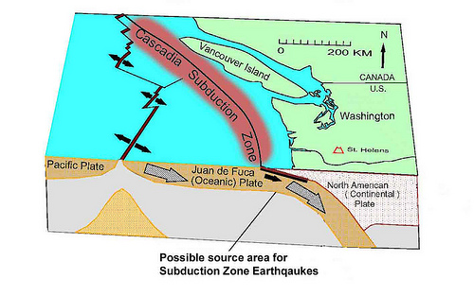
Subduction Zone Earthquakes
http://www.nwseismic.com/wp-content/uploads/2011/12/Cascadia-Subduction-Zone.jpg
Notes:
Subduction zone earthquakes occur where one tectonic plate moves under another tectonic plate.
In Washington, this could occur where the Juan de Fuca Plate sinks under the North America plate.
The Cascadia Subduction Zone is a convergent plate boundary off the Washington coast. The subduction zone extends from Northern California to British Columbia. In 2011, Japan experienced a subduction zone earthquake similar to what could occur on the Cascadia Subduction Zone. Damage to buildings designed for earthquakes was minor but damage to cell phone towers, bridges and water pipes was severe; infrastructure damage included thousands of damaged sections of roads and damage to over 70 bridges.

Slide 4
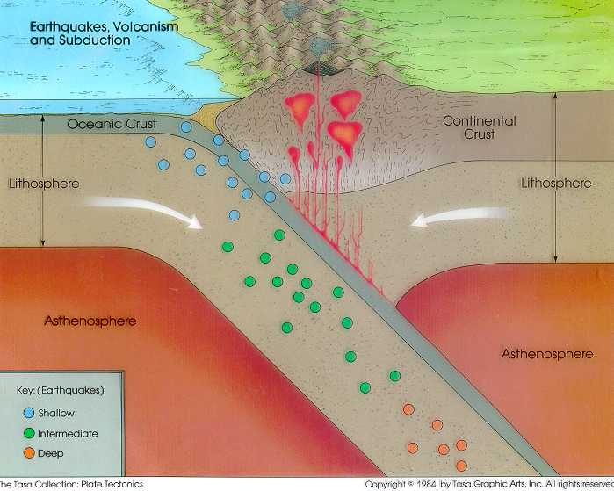
Deep Earthquakes
http://blue.utb.edu/paullgj/physci1417/Lectures/Plate_Tectonics.html
Notes:
Step-2
The image demonstrates where deep earthquakes occur (orange dots)
Deep earthquakes occur 21-43 miles below the earth’s surface.
Due to their depth, deep earthquakes are felt over a large area. The Nisqually earthquake in 2001 was felt from Salem Oregon to British Columbia.
The Nisqually earthquake lasted about 40 seconds. In the greater Seattle area, sections of roads were damaged; fissures opened up in the ground, and older masonry buildings were damaged. Inside buildings unsecured furniture was overturned and books and other items fell off of shelves.

Slide 5
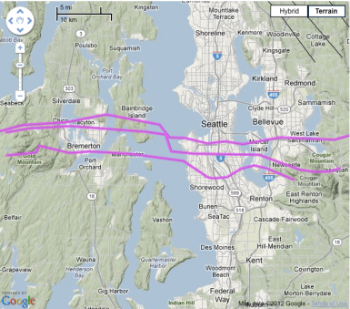
Shallow Fault Earthquakes
https://geohazards.usgs.gov/hazfaults/map2008.php
Notes:
Step 2-
This purple lines in this picture illustrate the locations of the Seattle Fault.
Shallow fault earthquakes occur 0-18 miles bellow the earth’s surface and are felt strongly at the surface.
A local example is the Seattle fault, which runs through Seattle.
Ground motions could be two to five times more intense than a deep earthquake.
Shaking would be powerful and there could be considerable damage to structures.
The Northridge earthquake in California, a shallow fault earthquake, caused the closure of several major highways and caused severe damage to bridges, electrical facilities and pipelines. Inside buildings, unsecured furniture was overturned and there was broken glass from light fixtures.

Slide 6
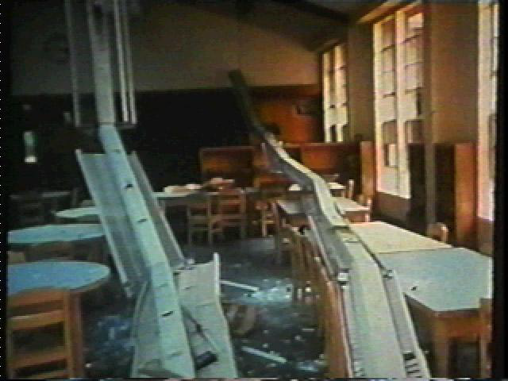
Earthquake Damage
Northridge, California earthquake
COGGS Mother Slide Show, 2008
Notes:
Northridge, California earthquake in 1994. This picture is taken after an earthquake event in California and shows fallen light fixtures and broken glass on student desks in a Northridge school room. Luckily, the school was closed when this event happened. If a student had engaged in “drop, cover and hold on” and had been under one of these desks they would have been protected from the falling lights/glass. Students remaining in their seats or trying to exit the classroom during shaking could have been injured.

Slide 7
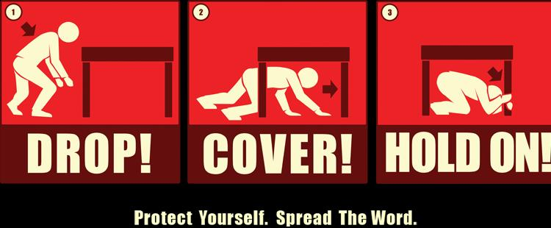
Drop, Cover and Hold On!
DROP – Drop to the ground! Do not run.
COVER – Get under your desk! Take cover under your desk. Cover your neck with your arm.
HOLD ON – Hold on to the desk! Hold on to the desk leg until the ground stops shaking.
http://www.smgov.net/uploadedImages/Departments/OEM/Events/Drop%20Cover%20%20Hold%20On.jpg
Notes:
STEP 4- Review the proper technique for “Drop Cover and Hold on”. Have the students practice drop, cover, and hold on.

Slide 8
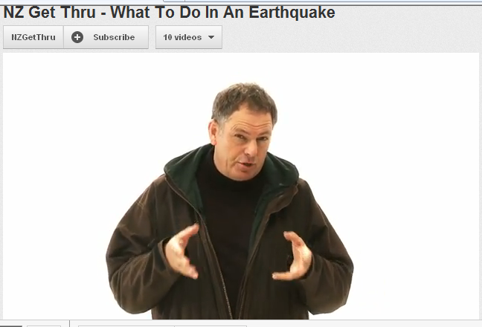
Drop, Cover and Hold On!
http://www.youtube.com/watch?v=-a7T9Uf-JB4&list=PL3C56E6070F6E1C81&index=6&feature=plpp_video
Notes:
In 2011, New Zealand experienced the large Christchurch earthquake. Here is a video from New Zealand teaching New Zealander’s how to protect themselves during earthquakes.

Slide 9
Stay Safe at School Activity
Image by Megan Waddell
Notes:
-“Before we begin the next activity, I want you to be thinking of the different ways you can remain safe during an earthquake. For example, what should you do in a room where there are no tables to get under?”
-In a room with no tables or desks, students should kneel against an interior wall and cover their neck, head and eyes away from light fixtures or falling debris. Glass can cut exposed skin and get into eyes.
In the next several slides, we’ll examine pictures taken in a local high school. Let’s imagine a nearby earthquake occurs while students are in this high school. We are going to look for potentially dangerous locations and where and how students could best protect themselves during the shaking.

Slide 10
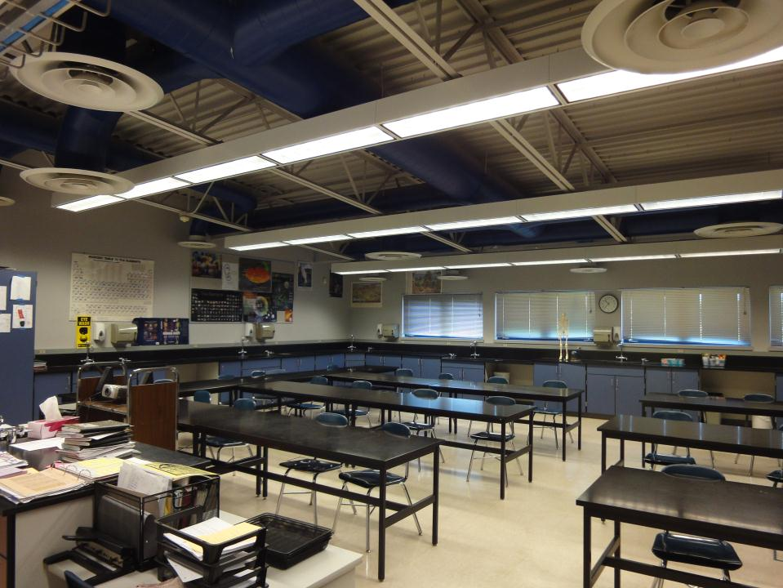
Classroom
Photo by Nora Jagielo
Notes:
See step six in Appendix B for a detailed explanation of activity.
The teacher shouldinstruct the students to raise their hand and identify any possible dangers in the classroom (The students have already brainstormed the dangers from their own classroom so this should be very similar). The instructor will record the answers on the whiteboard. Next, the instructor will call on students to identify all the “safe places”, such as desks or up against a wall. Once the students have a list of both “dangers” and “safe places” compiled on the whiteboard, the instructor will move to the next slide.

Slide 11
Classroom
Photo by Nora Jagielo
Notes:
See “Locations 1-6” in Step 6 of Appendix B to assist with the activity. Each location in the appendix will have a detailed description of the safe locations circled in green as well as the dangers circled in red.
Dangers: light fixtures, air-conditioning system (can dislodge from their ceiling mounts and come crashing down), glass from windows and ceiling reinforcements
Safe locations: under desks

Slide 12
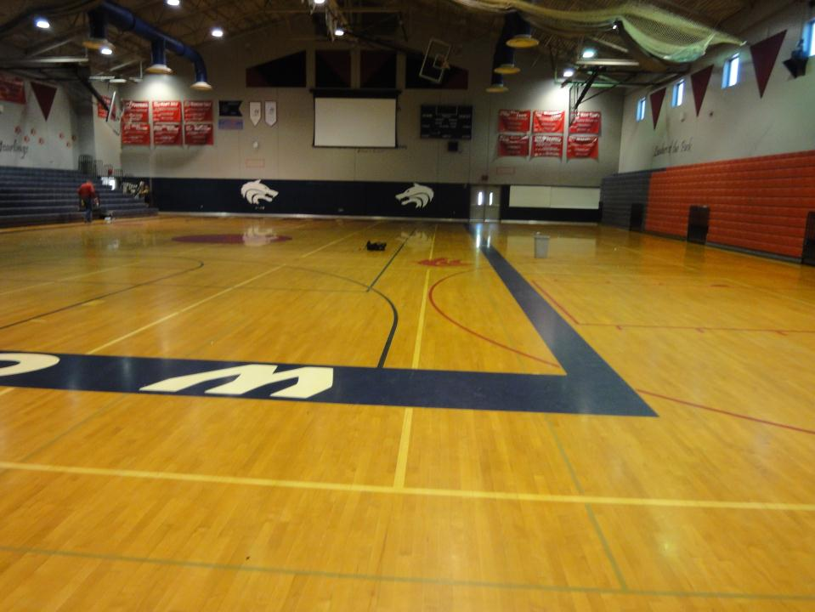
Gymnasium
Photo by Nora Jagielo

Slide 13
Gymnasium
Photo by Nora Jagielo
Notes:
Dangers: Glass from windows and light fixtures, basketball hoops and scoreboards (could shake loose from weak wall mounts)
Safe locations: Against the wall away from falling hazards, bleachers

Slide 14
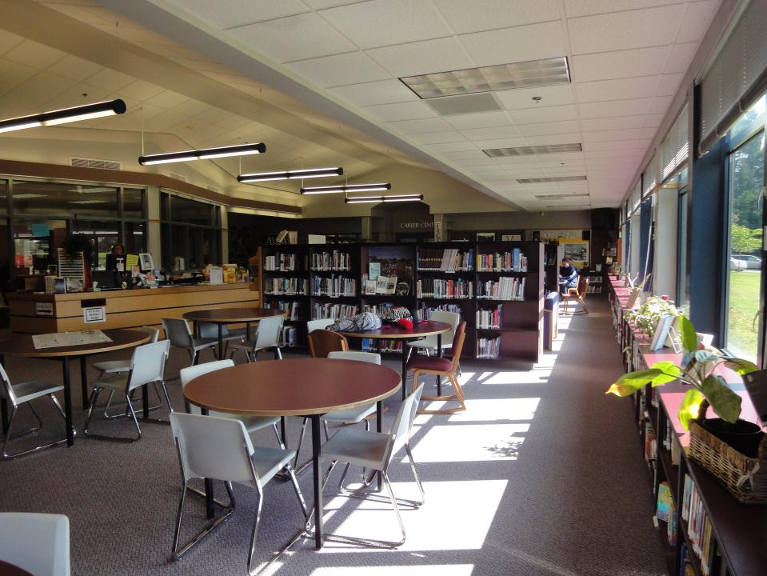
Library
Photo by Nora Jagielo

Slide 15
Library
Photo by Nora Jagielo
Notes:
Dangers: Light fixtures and accoustic ceiling tiles (if not tied appropriately to the ceiling, fixtures and tiles can fall during shaking), bookshelves (unrestrained shelves can topple over), books (falling books could bruise children kneeling near shelves, especially smaller children), glass from windows (can shatter)
Safe Locations: Underneath tables

Slide 16
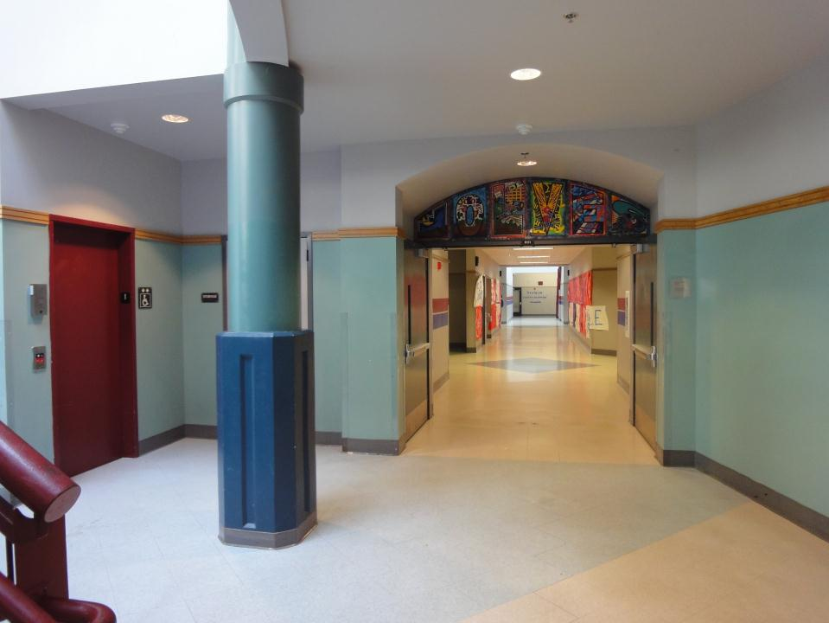
Hallway
Photo by Nora Jagielo

Slide 17
Hallway
Photo by Nora Jagielo
Notes:
Dangers: Glass from skylights and light fixtures, stairway (shaking could cause students to slip and fall), elevator (could become jammed and inoperable during the shaking).
Safe Locations: Kneel against the wall away from skylight and light fixtures

Slide 18
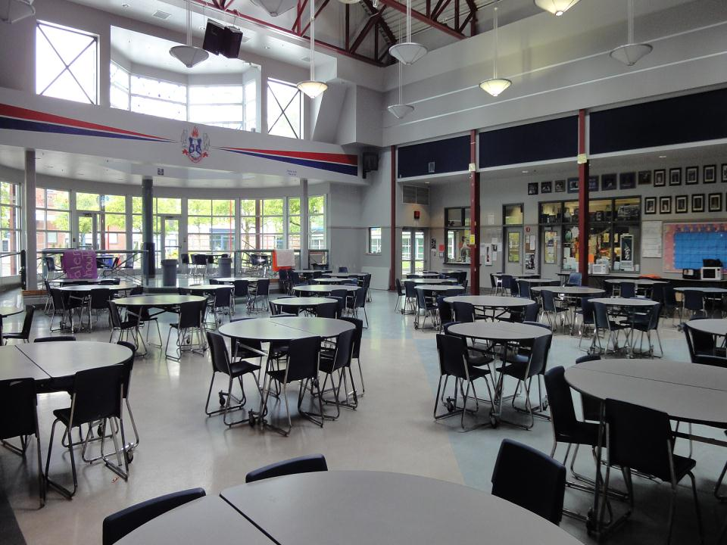
Cafeteria
Photo by Nora Jagielo

Slide 19
Cafeteria
Photo by Nora Jagielo
Notes:
Dangers: Hanging speakers, glass from windows, framed pictures, light fixtures.
Safe Locations: Underneath tables

Slide 20
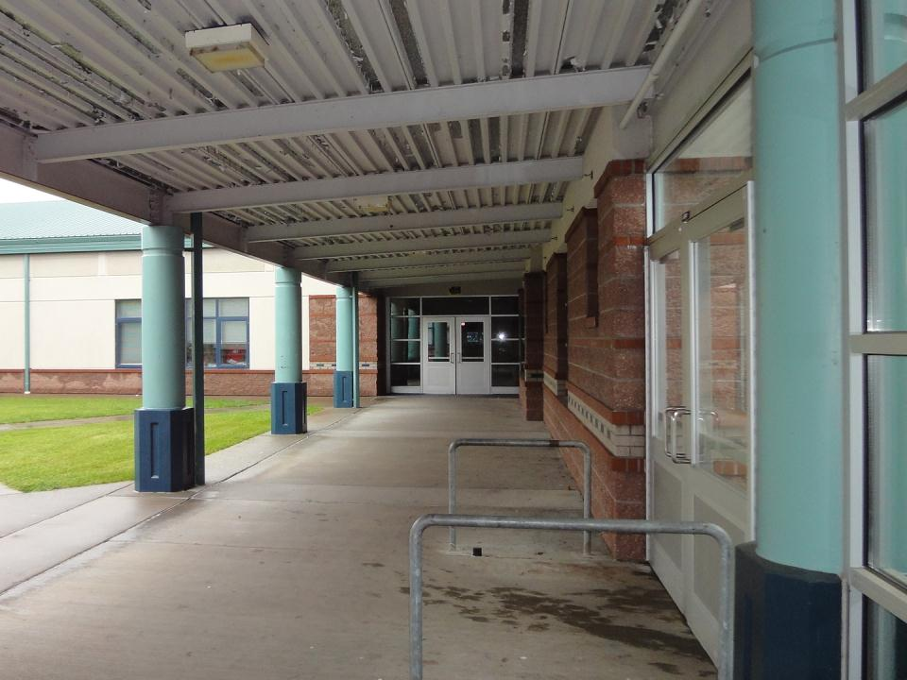
Outside near a building
Photo by Nora Jagielo

Slide 21
Outside near a building
Photo by Nora Jagielo
Notes:
Dangers: Glass from doors, windows and light fixtures
Safe Locations: Open Areas away from buildings

Slide 22
Acknowledgements
Outsmart the Quake! lesson plans are intended to support 6th-8th grade student learning about disaster preparedness in conjunction with the Washington State ShakeOut drill. The lessons were developed in 2012 by Western Washington University students Nora Jagielo, Pamela Griswold, Spencer Andrich, Pat Chappelle and Ryan Bainbridge as part of the Disaster Risk Reduction Planning Studio.
If you have questions, comments or concerns, please contact Dr. Rebekah Green at Western Washington University’s Resilience Institute. Rebekah.green@wwu.edu.

