Slide 1
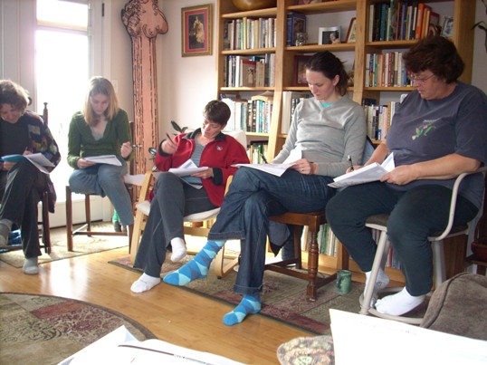
Community Preparedness
http://www.ashland.or.us/Page.asp?NavID=10752
Outsmart the Quake!
Lesson 4
Identifying resources and threats

Slide 2
Resources and Dangers
In this lesson you will learn about the resources and dangers communities have.
By the end of this lesson you will be able to:
  Identify the resources and dangers in your community
  Come up with ways to use resources to reduce, manage, or eliminate dangers

Slide 3


Your Neighbors: Resource
http://www.naccho.org/communications/blog/H1N1/Posts/december8.cfm
http://www.thechefalliance.com/Mise-En-Place-Service
Notes:
What types of skills do you neighbors have? It is important to identify what skills your neighbors have now, in order to fully utilize their skills in an emergency.

Slide 4
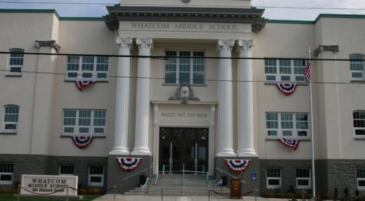
Schools: Resource
http://www.bhs1968.org/whatcom.html
Notes:
Schools can be used as shelters, supply distribution centers, and storage facilities

Slide 5
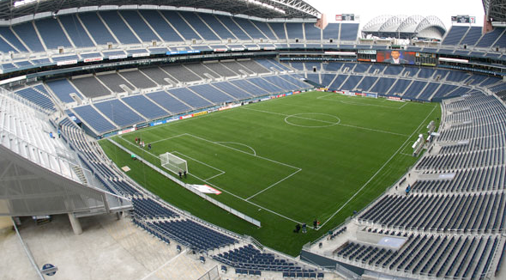
Stadiums: Resource
http://www.centurylinkfield.com/tour-centurylink-field/
Notes:
Stadiums can be used as shelters, supply distribution centers, and storage facilities

Slide 6
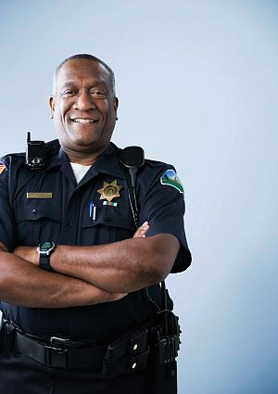
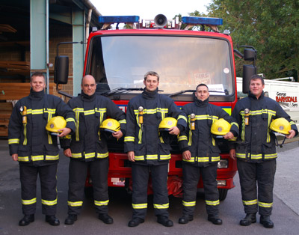
Are firemen and policemen resources?
http://www.essence.com/2010/07/20/dc-police-officers-awarded-900k/
http://www.tnfiremensassociation.org/
Notes:
Firemen and policemen are certainly resources, however, it may take several days for them to arrive. Students and their neighbors are the first responders.

Slide 7
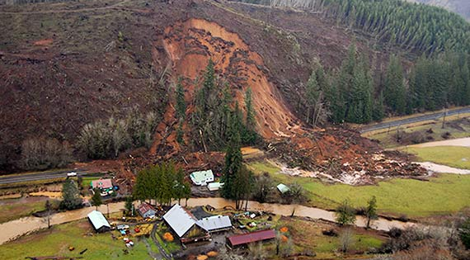
Landslides: Danger
http://www.swandeer.com/willapa/index.blog?topic_id=1086654
Notes:
Deforested hillsides are more susceptible to landslides because there is no vegetation to hold the soil in place. When heavy rain, seismic activity, or both, are added to the mix landsides are likely to occur. This is a picture of a landslide in Chehalis, Washington.

Slide 8
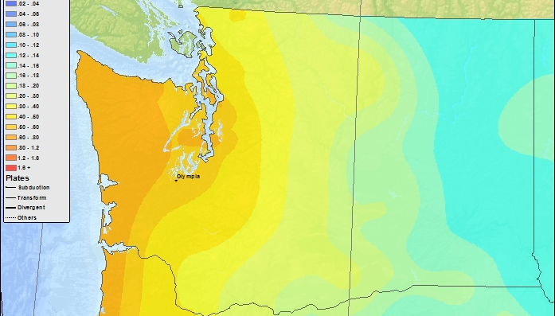
Earthquakes: Danger
http://earthquake.usgs.gov/earthquakes/states/washington/hazards.php
Notes:
As mentioned in lesson two, earthquakes are a threat to Western Washington. It may be beneficial to put a “you are here” box around your city.
(orange is high seismicity, blue is low seismicity)
Earthquake dangers
Broken glass - windows, lights, pictures (could fall or pierce a student during or after an earthquake)
Unsecured furniture (could fall on a student during or after an earthquake)
Projectors (could fall or a student during or after an earthquake)
High voltage power lines (could electrocute or fall on a student during or after an earthquake)
Streetlights (could fall on a student or potentially electrocute during or after an earthquake)
Utility wires – telephone, cable, electricity (could fall on or electrocute a student during or after an earthquake)
Water mains running under or near the school (if water mains are damaged, limited access to potable water)
Gas stations or industries with potentially explosive materials nearby (fires)
Parapets (could fall on a student during or after an earthquake)
Speakers (could fall on a student during or after an earthquake)

Slide 9
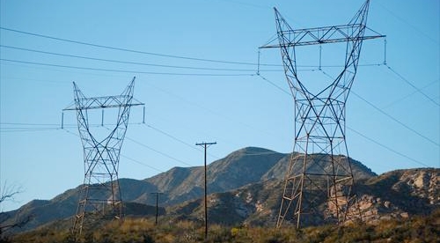
High Voltage Power Lines: Danger
http://gallery.usgs.gov/tags/powerlines
Notes:
High voltage power lines could fall on a student during or after an earthquake and/or electrocute a student

Slide 10
Brainstorm!
What types of resources does your community or neighborhood have?
What types of dangers could disrupt your community or neighborhood?
Notes:
OPTION 1 ONLY!
Guide the resource and danger discussion towards those that are visible on a map.
Examples of resources: neighbors (first aid, search and rescue, emotional support), community centers (shelter, supply distribution center, storage), schools (shelter, supply distribution center, storage), water sources (drinking water), community gardens (food), grocery stores (food, water, shelter, distribution center, storage), health centers (medical care, shelter, supply distribution center, storage), fire stations (shelter, supply distribution center, storage), generators (temporary electricity for heat, running water, cooking etc.), churches (shelter, supply distribution center, storage), airports (shelter, supply distribution center, storage), stadiums (shelter, supply distribution center, storage)
Examples of dangers: floodable rivers, steep slopes where landslides could occur, toxic waste/hazardous material sites (fire), seismic regions or zones, tsunami flood zones

Slide 11
Brainstorm!
What types of resources do we have here at school?
What types of skills would be useful in a disaster?
What types of dangers could an earthquake cause at school?
Notes:
OPTION 2 ONLY!
Guide the discussion toward resources found on school grounds. Particularly focus on the skills and school’s staff training useful in a disaster. Similarly, encourage the students to brainstorm threats visible on school grounds. Remind the students of the earthquake dangers they identified in lesson two.
Examples of resources: water, food, first aid supplies, generators, first aid/CPR skills, communication skills, message delivers, radio operators, look after younger children or the elderly, suppress fire, entertainers (see Appendix D for additional resources/skills)
Examples of earthquake threats: Broken glass (could fall on or pierce a student), unsecured furniture (could fall on a student), projectors (could fall on a student), speakers (could fall on a student), water mains running under or near school (if water mains are damaged, limited access to drinking water), gas stations nearby (fires), street lights (could fall on or electrocute a student), utility wires (telephone, cable, electricity – could fall on or electrocute a student), high voltage power lines (could fall on or electrocute a student), parapets (could fall on a student)

Slide 12
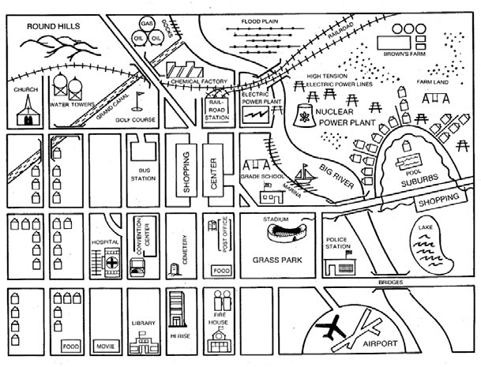
What are the resources and dangers?
National Curriculum and Assessment Centre, 2011
Notes:
Designed for OPTION 1, but can be used as a supplemental activity for OPTION 2

Slide 13
What are the resources and dangers?
National Curriculum and Assessment Centre, 2011
Notes:
Designed for OPTION 1, but can be used as a supplemental activity for OPTION 2
Resources in this image (green): neighbors, food, convention center, airport, stadium, grade school, lake, river, shopping center, hospital, fire house, Brown’s farm (food), church
Threats in this image (red): steep hills, gas/oil tanks, floodplain, chemical factory, high tension power lines, nuclear power plant, electric power plant

Slide 14
You are resources too!
Look after younger children
Take care of pets
Prepare basic meals
Assist in gathering supplies
Deliver messages
Identify hazards at home and at school
Move heavy objects to lower shelves
Rearrange bedrooms to make them earthquake safe
Encourage their families to prepare
Perform basic first aid
Entertain others during a stressful event (e.g. funny stories, jokes etc.)
Notes:
Suggested Dialog:
“You may not realize it, but the tasks you perform in your everyday life are incredibly useful in crisis situations. Watching after younger siblings, taking care of pets, and preparing meals are just a few of the contributions you can make to your community during a crisis. Additionally, you have the skills to prepare for earthquakes by moving heavy items to lower shelves, rearranging your bedroom, and encouraging your parents to prepare.”

Slide 15
Community Resource and Threat Mapping
A resource and danger map is a drawing of a community that shows the important buildings and roads along with the community’s resources and potential dangers.
Notes:
Supplementary homework assignment (See Appendix D for details)

Slide 16
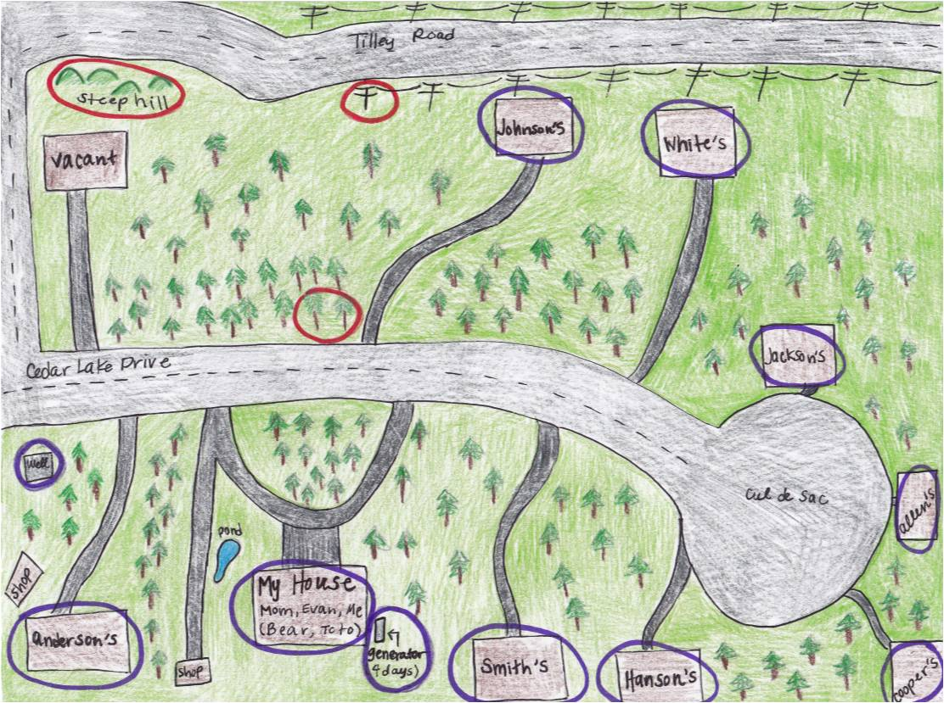
CPR/first aid
BBQ
Rain barrel
Garden
Contractor, day car, camping supplies
Resource
Danger
Garden
BBQ
First aid
Generator, teacher, babysit, look after pets, storage, garden, rain barrel, camping supplies, pond
Storage, BBQ,
fire extinguisher
Veterinarian
Secretary
Handyman
Camp stove
BBQ
Doctor
Teacher
Image by Nora Jagielo
Created by Nora Jagielo
Notes:
This is an example of a community resource and danger map for the supplemental homework assignment. Notice the map includes the resources, skills, and threats in the neighborhood.
Resources in map: neighbors, generators, storage sheds, BBQ’s, well (water source), garden, rain barrel, pond, camping supplies, fire extinguisher
Dangers in map: power lines, steep hill, trees (knocking down power lines or blocking road)

Slide 17
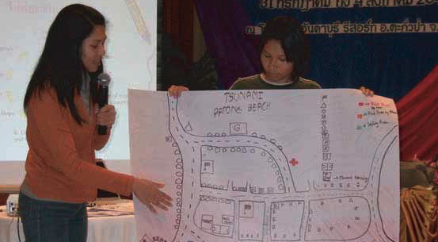
Resource and Danger Mapping Around the World
Save the Children Sweden – Southeast Asia and the Pacific Regional Office, 2007
Students in Thailand presenting a base map of their community. The base map will be used to create a resource and danger map.

Slide 18
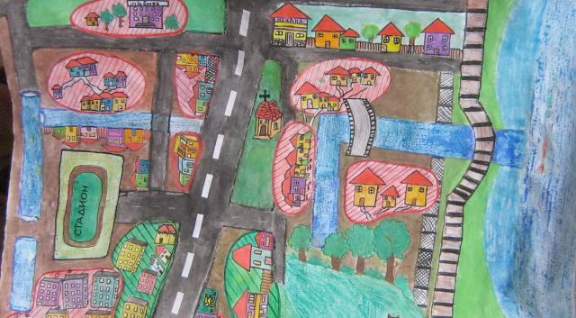
Resource and Danger Mapping Around the World
http://www.caritas-emergency.ro/international/?q=node/105
Resource and danger map created by students in Bulgaria
Caritas Emergency, 2011

Slide 19
Acknowledgements
Outsmart the Quake! lesson plans are intended to support 6th-8th grade student learning about disaster preparedness in conjunction with the Washington State ShakeOut drill. The lessons were developed in 2012 by Western Washington University students Nora Jagielo, Pamela Griswold, Spencer Andrich, Pat Chappelle and Ryan Bainbridge as part of the Disaster Risk Reduction Planning Studio.
If you have questions, comments or concerns, please contact Dr. Rebekah Green at Western Washington University’s Resilience Institute. Rebekah.green@wwu.edu.

